Slide 1
ISA 201 Intermediate Information Systems Acquisition

Slide 2
Lesson XX Software Quality Assurance

Slide 3
Today we will learn to:
Define software quality
Identify characteristics unique to software that impact quality
Identify characteristics of generic DOD software system domains (e.g. Platform IT, Command and Control, and Defense Business Systems), that might influence how each system is reviewed in a software quality program
Recognize that every IT acquisition program requires a Program Manager approved software quality statement.
Given several process-focused and product-focused software quality assurance methods, describe how each assures quality in a software acquisition
Recognize the benefits of applying Capability Maturity Model Integrated (CMMI) concepts and principles to a DoD SW development project
Given a software acquisition scenario, recognize the preferred method for identifying and tracking defects
Given an acquisition scenario with multiple software related programmatic issues, analyze how each may impact the program’s ability to meet its quality objectives

Slide 4
Lesson Plan
How is Software Different from Hardware?
What is Software Quality?
Software Domain Considerations
Lesson Exercise Part 1
Software Quality Assurance Planning and Methods
Lesson Exercise Part 2

Slide 5
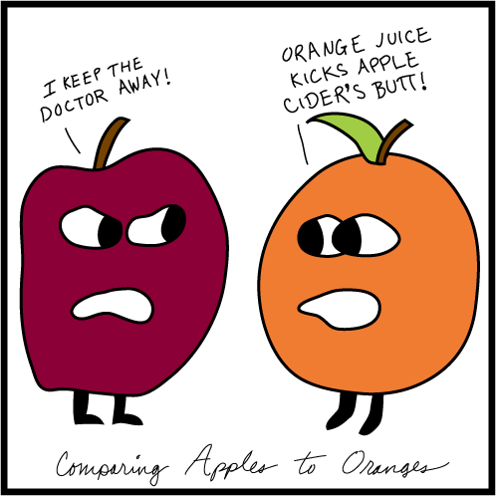
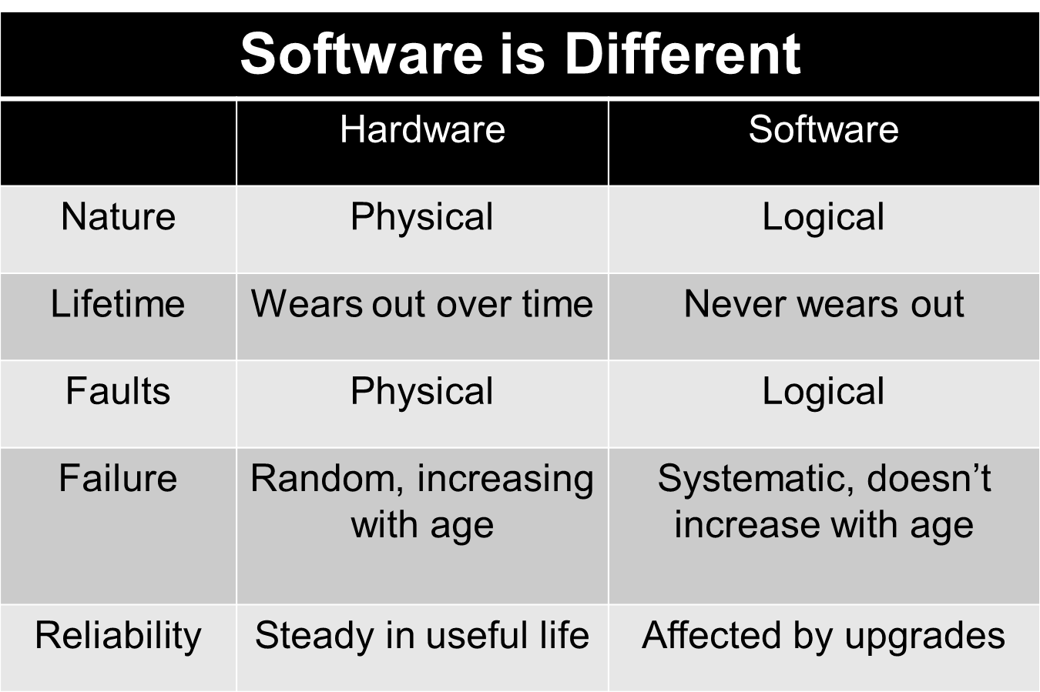
What Makes Software Different from Hardware

Slide 6
Lesson Plan Status
How is Software Different from Hardware?
What is Software Quality?
Software Domain Considerations
Lesson Exercise Part 1
Software Quality Assurance Planning and Methods
Lesson Exercise Part 2

Slide 7

Software Quality
THE ESSENCE:
Does it do what it is
supposed to?
Definitions for Software Quality
The degree to which a system, component, or process meets specified requirements [IEEE Std 610.12-1990]
The degree to which a system, component, or process meets customer or user needs or expectations (no undesirable properties) [ISO/IEC 9001}
Other Definitions
Lack of bugs
Adherence to a software quality model (“ilities”)
The Program Manager must understand and define software quality for his or her program

Slide 8
Software Quality Model Characteristics
ISO 9126-1 :2001 Software engineering -- Product quality provides a SW quality model that identifies six main quality characteristics:
Functionality
Suitability
Accurateness
Interoperability
Compliance
Security
Reliability
Maturity
Fault tolerance
Recoverability
Usability
Understandability
Learnability
Operability
Efficiency
Time behavior
Resource behavior
Analyzability
Maintainability
Changeability
Stability
Testability
Adaptability
Portability
Installability
Conformance
Replaceability

Slide 9
Lesson Plan Status
How is Software Different from Hardware?
What is Software Quality?
Software Domain Considerations
Lesson Exercise Part 1
Software Quality Assurance Planning and Methods
Lesson Exercise Part 2

Slide 10
Software Domain Considerations
Is there a relationship between software quality and software safety?
Is there a relationship between software quality and cybersecurity?
Mission
Systems
C4ISR systems – Security, interoperability
Platform IT (PIT) systems – Safety, Response time
C4ISR
Defense
Business
Systems
DBS systems – Privacy, interoperability
SW quality assurance practices should be chosen to meet the program’s quality objectives and informed by the risks inherent in the type of system being built.

Slide 11
Lesson Plan Status
How is Software Different from Hardware?
What is Software Quality?
How do I achieve Software Quality?
Lesson Exercise Part 1
Software Quality Assurance Planning and Methods
Lesson Exercise Part 2

Slide 12
Theater Network Management System (TNMS) Performance Analysis Exercise 1
Review the history and status of the TNMS program. (Read “TNMS Exercise 1” document).
Identify and prioritize information needs relevant to the program manager (reference the ICM table in exercise folder).
Map the information needs to measurable concepts and potential measures.
Include key aspects of the Software Quality Model Characteristics
Include Domain and any safety and cybersecurity quality implications
Summarize your IPT’s results in a briefing.

Slide 13
Lesson Plan Status
How is Software Different from Hardware?
What is Software Quality?
How do I achieve Software Quality?
Lesson Exercise Part 1
Software Quality Assurance Planning and Methods
Lesson Exercise Part 2

Slide 14
Software Quality Assurance Methods
Process Assurance
Product Assurance
systematic activities providing evidence of the ability of the software process to produce a software product fit for use
Process maturity and compliance
Risk Management
Independent oversight
SQA audits and reporting
systematic activities providing evidence that the software product performs as specified
Desk Checking
Walk-Throughs
Formal Inspections
Joint Reviews
Computer-Based Testing
Product Quality Measures

Slide 15
Quality Program
A quality program includes a management process that is capable of ensuring the following key activities:
Formulating a quality management plan
Applying software engineering principles
Conducting formal technical reviews
Applying a multi-tiered testing strategy
Enforcing Process adherence
Controlling change and measuring the impact of change
Performing SQA audits, keeping records and reporting
The PM should allow contractors to define and use a preferred quality management process that meets required program support capabilities.
The DOD does not require third party certification or registration of a supplier’s quality system
The PM is ultimately responsible for setting the quality objectives!

Slide 16
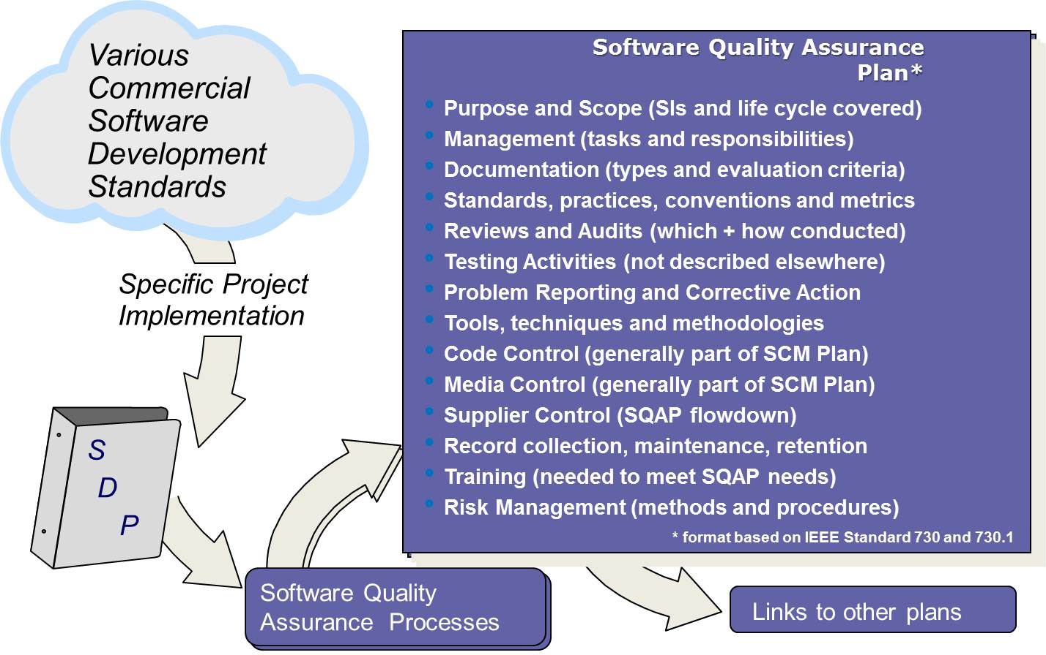
Software Quality Assurance Plan

Slide 17
Process Assurance
Software Engineering
The application of a systematic, disciplined, quantifiable approach to the development, operation, and maintenance of software; that is, the application of engineering to software. [IEEE Std 610.12-1990]
Software Cleanroom Engineering
Combines formal methods of requirements and design with statistical usage testing to produce software with nearly none or no defects.
Normally used in systems requiring highly reliable software (space shuttle)
Continuous Process Improvement
A strategic approach for developing a culture of continuous improvement in the areas of reliability, process cycle times, costs in terms of less total resource consumption, quality, and productivity.
Six Sigma: A disciplined approach and methodology for reducing variations in system output.
Lean Six Sigma: A disciplined, data-driven approach and methodology for eliminating defects in any process — from manufacturing to transactional and from product to service.
Theory of Constraints: a management paradigm that views any manageable system as being limited in achieving more of its goals by a very small number of constraints.

Slide 18
Process Assurance: Capability Maturity Model—Integration (CMMI)
Capability Maturity Model® Integration (CMMI)
Was a collaborative effort sponsored by the Office of the Secretary of Defense/Acquisition and Technology (OSD/A&T) Systems Engineering with participation by government, industry, and the Software Engineering Institute (SEI)*.
Objective is to develop a product suite that provides industry and government with a set of products to support process and product improvement.
It can be used to guide process improvement across a project, a division, or an entire organization.
Benefits of implementing process improvement:
The quality of a system is highly influenced by the quality of the process used to acquire, develop, and maintain it.
Process improvement increases product and service quality as organizations apply it to achieve their business objectives.
Process improvement objectives are aligned with business objectives.
CMMI maturity level can often be a good predictor of whether a software development project will incur cost and schedule overruns.
CMMI Institute http://cmmiinstitute.com/
*CMMI is a spin-off of original SEI activity

Slide 19
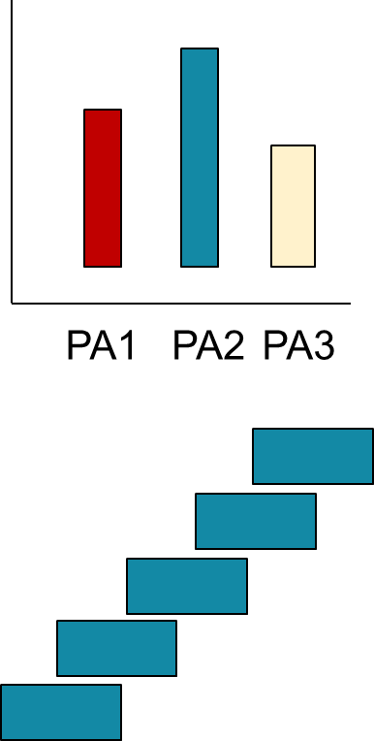
Process Assurance: Capability Maturity Model—Integration (CMMI)
CONTINUOUS
Path enables organization to incrementally improve processes corresponding to an individual process area (PA) (or group of process areas) selected by the organization.
STAGED
Path enables organization to improve a set of related processes by incrementally addressing successive sets of process areas.

Slide 20
Process Assurance: Capability Maturity Model—Integration (CMMI)
Level | Continuous Representation Capability Levels | Staged Representation Maturity Levels
Level 0 | Incomplete
Level 1 | Performed | Initial
Level 2 | Managed | Managed
Level 3 | Defined | Defined
Level 4 |  | Quantitatively Managed
Level 5 |  | Optimizing
Capability levels enable your organization to focus its process improvement efforts process area by process area from capability level 0 to capability level 3.
Maturity levels provide a staging of processes for improvement across your organization from maturity level 1 to maturity level 5.

Slide 21
Process Assurance: More Quality Process Models and Standards
ISO 9000, Quality Management and Quality Assurance Standards
Provides guidelines as to which document to use and how to use it.
Use of ISO 9001, 9002 or 9003 depends on business structure
ISO 9001, Quality Systems
Model for Quality Assurance in Design/Development, Production Installation, and Servicing
ISO 9002, Quality Systems
Model for Quality Assurance in Production and Installation
ISO 9003, Quality Systems
Model for Quality Assurance in Final Inspection and Test
ISO 9004, Quality Management and Quality Systems Element
Along with ISO 9000, ISO 9004 is an advisory document.
ISO 9001 gives the requirements that an organization must do to manage the processes affecting quality of its products and services
ISO 9000 - Quality management://www.iso.org/iso/iso_9000

Slide 22
Other Quality Standards and Initiatives
SPICE (SW Process Improvement and Capability Determination) (ISO/IEC 15504)
An international standard for software process assessment.
Derived from process lifecycle standard ISO 12207 and ideas of maturity models like Bootstrap, Trillium and the CMM.
Control Objectives for Information and related Technology (COBIT)
Provides good practices across a domain and process framework.
Practices designed to help optimize IT-enabled investments, ensure service .delivery and provide a measure against which to judge when things do go wrong..
Information Technology Infrastructure Library (ITIL)
Provides international best practices for IT service management.
Consists of a series of books giving guidance on the provision of quality IT. services, and on the accommodation and environmental facilities needed to support IT.
Practical Software and Systems Measurement (PSM)
Best practices within the software/system acquisition and engineering communities.
Goal is to provide Project Managers with the information needed to meet cost, schedule, and technical objectives on programs.

Slide 23
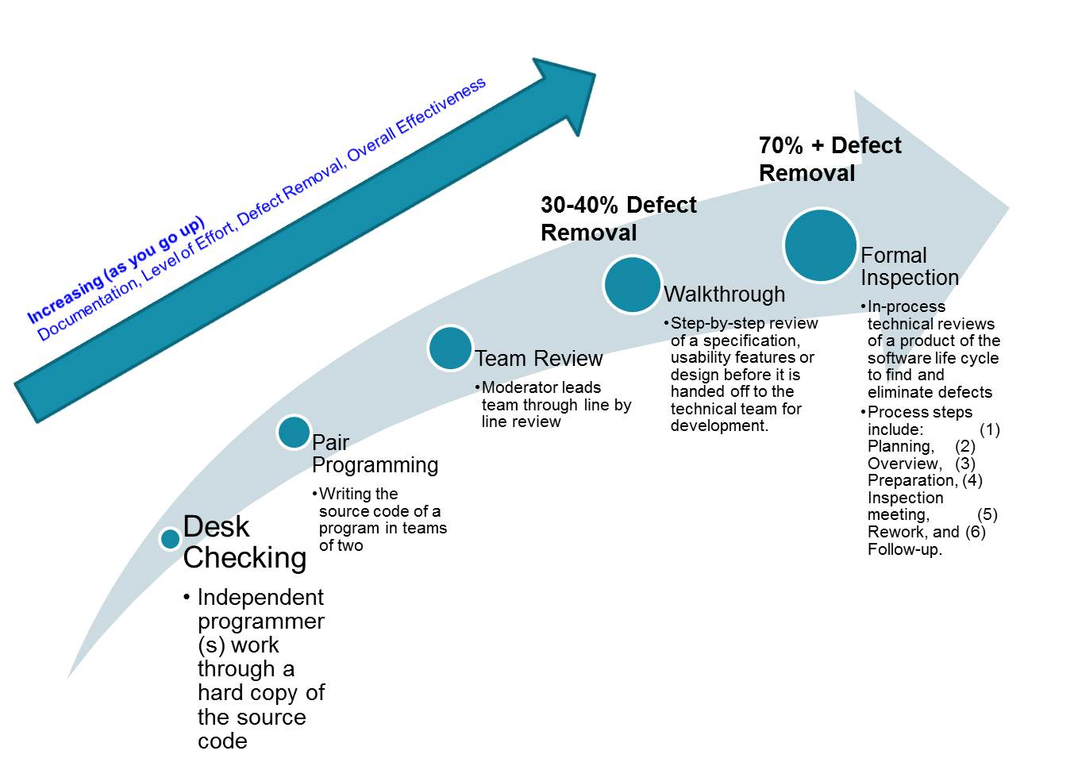
Product Assurance: Human–based Testing

Slide 24
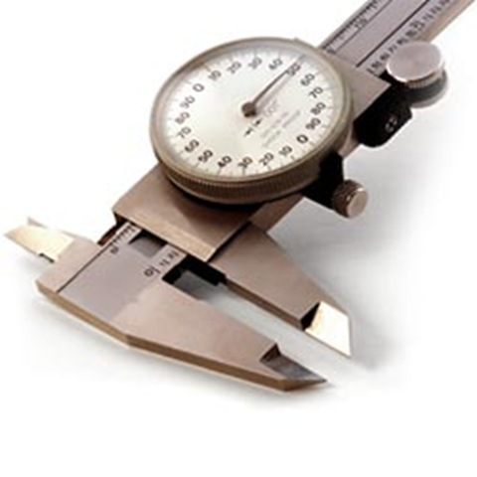
Product Assurance: Measures
Low Defect Potentials (< 1 per function point)
High Defect Removal (> 95%)
Unambiguous, Stable Requirements (< 2.5% change)
Explicit Requirements Achieved (> 97.5% achieved)
High User Satisfaction Ratings (> 90% “Excellent”)
Installation
Ease of Learning
Ease of Use
Functionality
Compatibility
Various internal DoD and GAO reports and studies have indicated that establishing meaningful measures and using them to manage contributes to program success

Slide 25
Product Assurance: Measures
Establish Requirements
Identify list of possible quality requirements
Determine list of quality requirements
Assign a direct metric to each quality requirement
Identify Metrics
Apply the software quality metrics framework
Perform a cost-benefit analysis
Gain commitment to the metrics
Implement Metrics
Define the data collection procedures
Prototype the measurement process
Collect the data and compute the metric values
Analyze Results
Interpret the results
Identify software quality
Make software quality predictions
Ensure compliance with requirements
Validate Metrics
Apply the validation methodology
Apply the validity criteria
Apply the validation procedures
Document results
IEEE Standard for a Software Quality
Metrics Methodology
IEEE Std 1061-1998 (reaffirmed 2009)

Slide 26
Lesson Plan Status
How is Software Different from Hardware?
What is Software Quality?
How do I achieve Software Quality?
Lesson Exercise Part 1
Software Quality Assurance Planning and Methods
Lesson Exercise Part 2

Slide 27
TNMS Performance Analysis Exercise 2
Read “TNMS Exercise 2” document
Review carefully the set of charts for TNMS to identify problems, assess their impact, project the outcomes, and evaluate alternatives. Do the data provided meet your information needs?
Use the Performance Analysis Worksheets (after the charts) to record your findings. For question number 1, team assignments are given for each indicator. Questions 2 and 3 are to be answered by all teams
Summarize your IPT’s results in a briefing.
During IPT briefings, the class will discuss, compare, and contrast all IPT findings.

Slide 28
Today we learned to:
Define software quality
Identify characteristics unique to software that impact quality
Identify characteristics of generic DOD software system domains (e.g. Platform IT, Command and Control, and Defense Business Systems), that might influence how each system is reviewed in a software quality program
Recognize that every IT acquisition program requires a Program Manager approved software quality statement.
Given several process-focused and product-focused software quality assurance methods, describe how each assures quality in a software acquisition
Recognize the benefits of applying Capability Maturity Model Integrated (CMMI) concepts and principles to a DoD SW development project
Given a software acquisition scenario, recognize the preferred method for identifying and tracking defects
Given an acquisition scenario with multiple software related programmatic issues, analyze how each may impact the program’s ability to meet its quality objectives

