Slide 1
ISA 201 Information System Acquisition

Slide 2
Lesson 13 Systems Development

Slide 3
Today you will learn to:
Compare and contrast the major DoD software development paradigms and recognize new development paradigms and trends.
Identify best practices in order to reduce software assurance vulnerabilities.
Identify unique issues and costs associated with Commercial Off The Shelf (COTS) components and software systems during a software development effort.
Identify the laws and policies requiring the use of software assurance.

Slide 4
Lesson Plan
Software Life Cycle Development Approaches
Software Assurance
Integrating Commercial Off the Shelf (COTS) Products
Exercise
For tomorrow read: Pages 1–4, 19 of When You Are Agile You Get Lean
(located in the Lesson 14 References folder)

Slide 5
Software Development Approaches Explained
Waterfall (Linear Sequential)
Step by step development
Can’t begin one phase until previous phase is complete
Can successfully use when requirements are well understood at the start with very little changes
Incremental
A series of waterfall cycles
Requirements known at the start and are divided into groups
Identify a core set of functions for the first phase and build on it
Best used with known requirements and when immediate functionality is needed
Spiral
Can combine waterfall, evolutionary, and incremental
Each spiral identifies high risk problems and develops solutions
Each cycle ends in a review in which stakeholders agree on plans for the next cycle
Agile
A group of software development methods which adhere to the Agile Manifesto
Emphasizes adaptability, customer collaboration and continuous delivery of valuable software

Slide 6
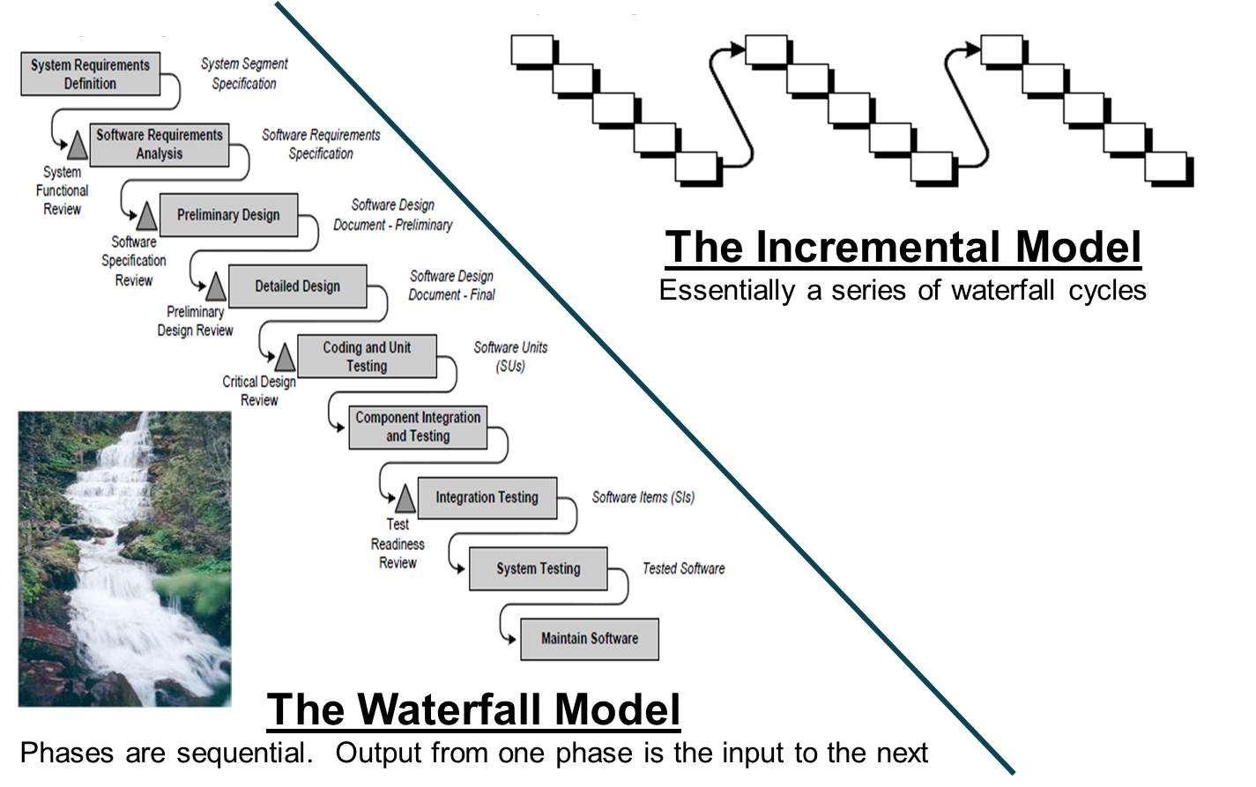
Software Development— Waterfall and Incremental

Slide 7
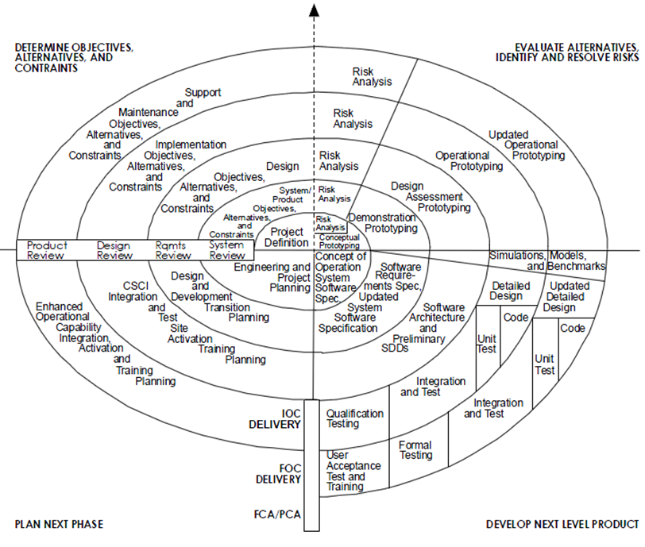
Software Development—Spiral
Spiral Model
Designed to reduce technical risks and incorporate new technology and innovations. Requirements are “discovered” through development.

Slide 8
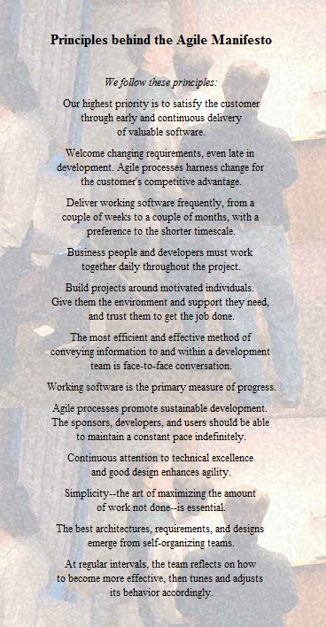
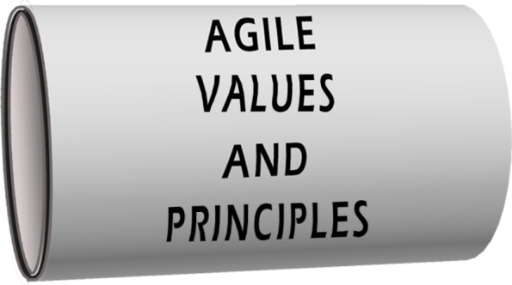
Software Development—Agile
Individuals and interactions
over Processes & tools
Working software
over Comprehensive documentation
Customer collaboration
over Contract negotiation
Responding to change
over Following a plan

Slide 9
What is Agile?
What is Agile?
Lean
Sprint
Minimum Viable Product
Return, Right Here, Right Now
Scrum
Product Backlog
Find Some Users and Make Them Happy
More Frequent Releases of Smaller Things
User Stories
Don’t Just Do Agile, Be Agile!
Agile software development is a method of software development that utilizes an iterative development process, designs services based on real user needs, and constantly improves software from user feedback.
DSDM
Dynamic Systems Development Method
Kanban
TechFAR Handbook: Procuring Digital Services Using Agile Processes under the FAR
XP (Extreme Programming)
Self Organizing Teams
Burndown Lists
Incremental, Iterative Deliveries
4

Slide 10
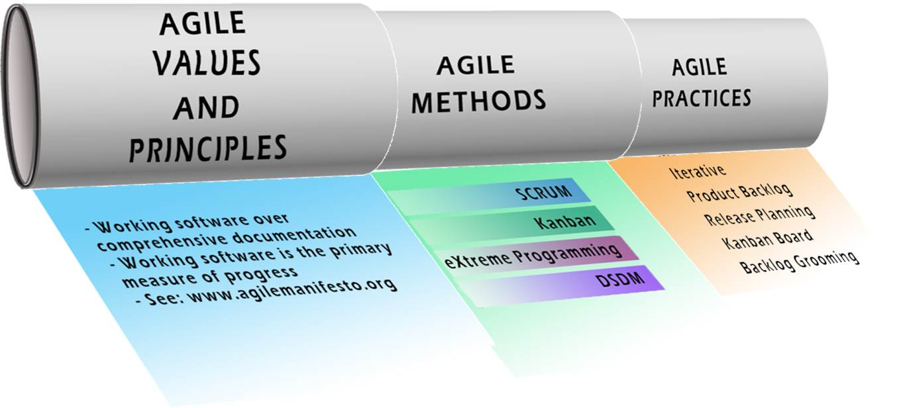
Agile Methods

Slide 11
Agile Practices
Time boxing | Unit testing
Increment | Continuous Integration
Iteration | User Stories
Definition of Done | Velocity
Product Backlog | Sustainable Pace
Release Planning | Prototyping
Estimation | Backlog Grooming
Daily Stand-up | AND MANY MANY MORE

Slide 12
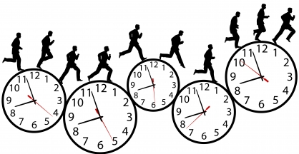
Agile Practice—Time boxing
Agile Practice: a previously agreed period of time during which a person or a team works steadily towards completion of some goal.
Why: Parkinson's law—"work expands so as to fill the time available for its completion".
Pre-Agile Examples: Pomodoro technique, Time-Constrained Project Management.

Slide 13
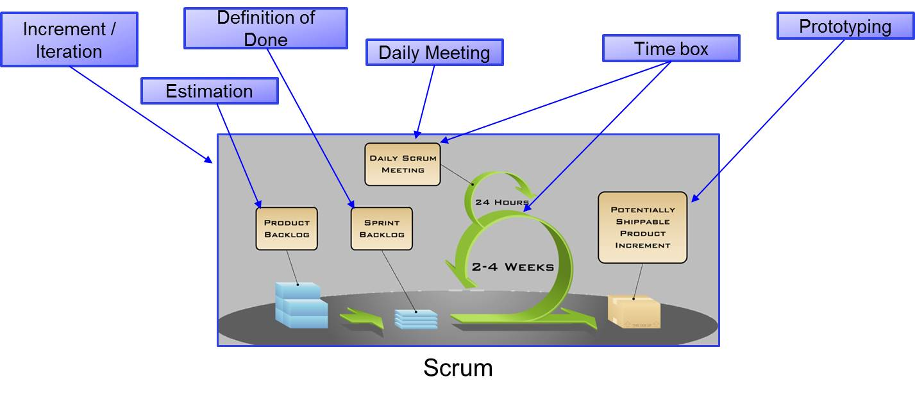
What is the purpose of Agile Methods?
Put a subset of the practices together to use as a STARTING point!

Slide 14
Barriers + Challenges
Disconnects between Agile Practices & Standard DoD Acquisition Lifecycle
Documentation & Milestone Reviews
Estimating
EVM
Scheduling
Self-Organizing Teams vs. Rigid Personnel Hierarchy
How to Measure Success?
Scaling
Team Size
Program Length
Complexity
Product Size
Limited Metrics to Measure ROI
17
PARCA Agile and EVM PM Desk Guide

Slide 15
Software Development Approaches Advantages and Disadvantages
Incremental
Advantages
Later development cycles can learn form previous cycles due to feedback
Risks spread over multiple cycles
Can test smaller portions of system easier
Disadvantages
Must know most requirements at the start
Cost and schedule overruns may result in an unfinished system
Waterfall
Advantages
System is well documented
Phases correspond with project management phases
Disadvantages
Deal with all risks in a single developmental effort
No working project until late
Minimal feedback
Spiral
Advantages
Improved Risk Management
Allows for better requirements definition
More responsive to user needs
Disadvantages
More complex and harder to manage than other models
Development costs are higher
Schedule time is often increased
Agile
Advantages
Early insight / buy-in by the stakeholders / users
Early course correction / “fail fast”
Disadvantages
More dependence on tacit knowledge (e.g., less explicit documentation)
Dependence on availability of user/customers
Difficult aligning artifacts and measures with those of the larger traditional acquisition

Slide 16
Lesson Plan Status
Software Life Cycle Development Approaches
Software Assurance
Integrating Commercial Off the Shelf (COTS) Products
Exercise

Slide 17
Software Assurance Defined
Software Assurance—the level of confidence that software is free from vulnerabilities, either intentionally designed into the software or accidentally inserted at any time during its life cycle, and that it functions in the intended manner [CNSSI No. 4009].
Software Assurance—The level of confidence that software functions as intended and is free of vulnerabilities, either intentionally or unintentionally designed or inserted as part of the software throughout the lifecycle (NDAA 2013 Section 933).
Software assurance focuses on the management of risk and assurance of safety, security, and dependability within the context of system and software life cycles [ISO/IEC 15026].
Software Assurance in Acquisition: Mitigating Risks to the Enterprise, Building Security In, Oct 2008

Slide 18
Software Assurance & Public Law
Public Law 111-383, National Defense Authorization Act (NDAA) for Fiscal Year 2011, section 932, Strategy on Computer Software Assurance:
Required report back to congress on SwA status
Public Law 112-239-January 2, 2013, NDAA for Fiscal Year 2013, Section 933, Improvements in Assurance of Computer Software Procured by the Department of Defense:
A research and development strategy to advance capabilities in software assurance and vulnerability detection
The state-of-the-art of software assurance analysis and test
How the Department might hold contractors liable for software defects or vulnerabilities
Public Law 113-66, NDAA for Fiscal Year 2014, Section 937, Joint Federated Centers for Trusted Defense Systems for the Department of Defense:
Establishes Joint Federated Assurance Center (JFAC) which provides vulnerability analysis and mitigation support to programs

Slide 19
Software Assurance & DoD Policy
DoDI 5000.02 Operation of the Defense Acquisition System
Baselines SwA policy for covered systems
Requires automated SwA tool use and SwA practice across the DoD Acquisition life cycle
DoDI 5200.44 Trusted Systems and Networks mandates:
Automated SwA tool use across the life cycle
Risk management of mission-critical functions and components
Testing and Evaluation, to detect HW/SW vulnerabilities
DoD-unique application-specific integrated circuits (ASICs) must be procured from trusted certified suppliers
Plans and mitigations documented in program protection and information assurance activities

Slide 20
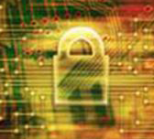
Building Secure Software
75% of current hacks target applications*
SW must be able to:**
Resist Attack or withstand anticipated attacks
Recover rapidly and mitigate damage from attacks
Keys to secure software:**
Security focused development—processes that help developers root out and remove exploitable defects…or prevent entirely
Security enhanced acquisition—processes that address risks in the supply chain
Build Security In–https://buildsecurityin.us-cert.gov/
“Functional Correctness must be exhibited even when SW is subjected to hostile conditions; therefore, claims about system reliability, integrity and safety must include provisions for built-in security of enabling SW.”**
Sources: *Gartner; **DHS National Cyber Security Division

Slide 21
Primary Causes of Software Vulnerabilities
Lack of Developer Motivation: Because consumers reward software vendors for being first to market and adding new features to their products, rather than for producing software that is better or more secure, vendors have no financial incentive to do the latter.
Lack of Developer Knowledge: Software is so complex; it exceeds the human ability to fully comprehend it, or to recognize and learn how to avoid all of its possible faults, vulnerabilities, and weaknesses. This factor, combined with lack of developer motivation, is often used as an excuse for not even teaching developers how to avoid those faults, vulnerabilities, and weaknesses that are within their ability to comprehend and avoid.
Lack of Technology: Current tools are inadequate to assist the developer in producing secure software or even to reliably determine whether the software the developer has produced is secure.
Andy Ozment, “Research Statement” [web] (Cambridge, UK: University of Cambridge,).

Slide 22
Building Security In
Vulnerable software may permit the following:
Unintentional errors leading to faulty operations that result in destruction of information or major disruption of operations
Intentional insertion of malicious code intent on loss of life, destruction of information, major disruption of operations, or even destruction of critical infrastructure
Theft of vital information that is sensitive or classified
Theft of personal information
Changed product, inserted agents, or corrupted information.
Software Assurance in Acquisition: Mitigating Risks to the Enterprise, Building Security In, Oct 2008
“Ultimately, we believe that there is no alternative to making security a part of the software contracting. Currently, we believe that there are serious misunderstandings about the security of code being delivered under many software development contracts. This can only lead to expensive litigation and a decision made by individuals with little software experience or understanding.” The Open Web Application Security Project (OWASP) Foundation

Slide 23
Lesson Plan Status
Software Life Cycle Development Approaches
Software Assurance
Integrating Commercial Off the Shelf (COTS) Products
Exercise

Slide 24
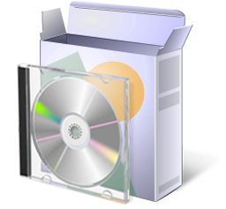
Commercial Off the Shelf (COTS) and Software Development
COTS Defined
A COTS product is a product
Sold, leased, or licensed to the general public
Offered by a vendor trying to profit from it
Supported and evolved by the vendor, who retains the intellectual property rights
Available in multiple, identical copies
Used without modification of the internals
* Any given version of a COTS component will reach eventual obsolescence or end of life in which it will no longer be supported by the vendor
Almost always requires **“glue code”(middleware) to integrate into existing software architecture
**Glue Code—code that does not contribute any functionality towards meeting the program's requirements, but instead serves solely to "glue together" different parts of code that would not otherwise be compatible.
* Source: Added Sources of Costs in Maintaining COTS-Intensive Systems, Clark,
CrossTalk, June 2007

Slide 25

COTS, Always the Best Solution? Elephant Bungee Wisdom
Universal Truth #9: COTS are not necessarily the best solution. They bring risks + benefits…understand both!
Management Emphasis
Investigate the pricing structure
Select established products with large installed bases
Budget for the complete cost of COTS integration and maintenance
“Fly before you buy” + TEST a lot
Adapt your requirements to COTS
Elephant Bungee Jumping #9: Avoiding Diseases that Are Fun to Catch

Slide 26

COTS and Modification Elephant Bungee Wisdom
Universal Truth #9: COTS are not necessarily the best solution. They bring risks + benefits…understand both!
Universal Truth # 8: Never allow developers to modify COTS software products
Management Emphasis
JUST SAY NO!
An absolute prohibition
Never pay a COTS vendor to specifically tailor or modify their product for you
Elephant Bungee Jumping #9: Avoiding Diseases that Are Fun to Catch
Elephant Bungee Jumping # 8: A Poke In the Eye With A Sharp Stick

Slide 27
COTS—Sources of Added Costs (Compared to custom applications)
Licensing
Evaluation of New Releases
Defect Hunting
Vendor Support
Upgrade Ripple Effect
Hardware Upgrades
Disabling New Features
Early Maintenance
Market Watch
Continuous Funding
Source: Added Sources of Costs in Maintaining COTS-Intensive Systems, Clark, CrossTalk, June 2007

Slide 28
Different COTS System Compositions
COTS Solution Systems
Typical business or standard IT systems
Major COTS component is essentially the system
Has its own architecture
Has internal business logic that must be followed to be used
COTS-Intensive Systems (CIS)
Comprised of many COTS components
Often safety and performance critical systems
User interface and data transmission may be handled by many components
Interact with each other through custom-developed “glue code” using vendor provided application program interfaces and with custom-developed application code
Source: Added Sources of Costs in Maintaining COTS-Intensive Systems, Clark, CrossTalk, June 2007

Slide 29
COTS-Intensive Systems— Impact on Sustainment
System obsolescence, technology refresh, and upgrade planning
Each COTS software product life cycle includes updates, refreshes, and obsolescence (i.e., unsupported releases).
Life cycle is not based on the users’ requests or budgetary cycles, but rather on marketplace demands and COTS software vendors’ business plans.
Source code escrow
Source code may be owned by the COTS vendor or the third-party integrator.
Problems can arise when the COTS vendor goes out of business or no longer exists due to a business merger or acquisition.
Vendor license management
During development, licenses may be managed by the system integrator.
The transition of license management tasks to the sustainment organization needs to be jointly planned by the program office and sustainment organization.
Architecture and COTS software interfaces
During system development, third-party integrators/ developers may capitalize on relationships with COTS software vendors to acquire system-specific capabilities.
These capabilities may not be in the official version of the product and there is no guarantee that these “extra” features will be maintained as the product evolves.

Slide 30
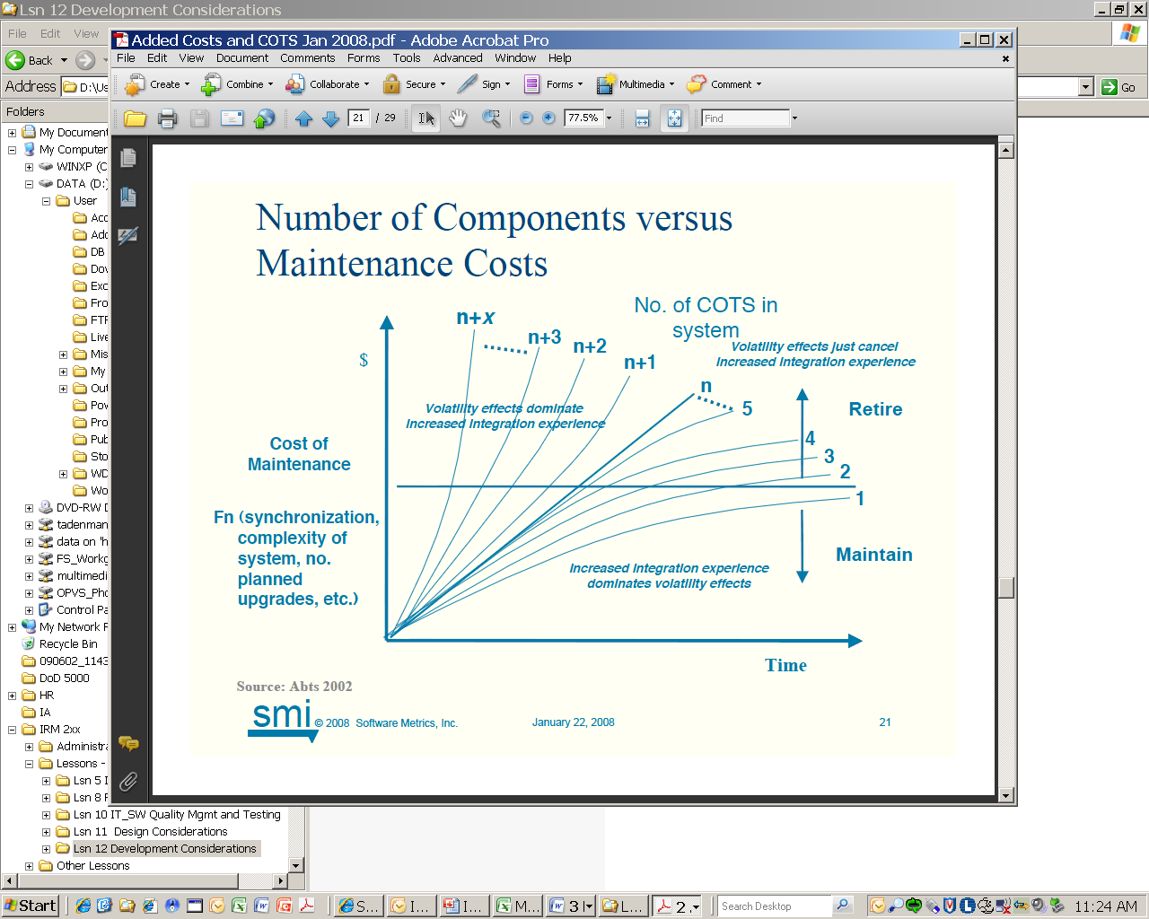
COTS—Number of Components vs. Maintenance Costs
Chart illustrates that maintenance costs increase steeply as the number of COTS components increase
Source: Added Sources of Costs in Maintaining COTS-Intensive Systems, Clark, CrossTalk, June 2007

Slide 31

COTS and Modification Elephant Bungee Wisdom
Universal Truth #9: COTS are not necessarily the best solution. They bring risks + benefits…understand both!
Universal Truth # 8: Never allow developers to modify COTS software products
Management Emphasis
JUST SAY NO!
An absolute prohibition
Never pay a COTS vendor to specifically tailor or modify their product for you
Elephant Bungee Jumping # 8: A Poke In the Eye With A Sharp Stick

Slide 32
Lesson Plan Status
Software Life Cycle Development Approaches
Software Assurance
Integrating Commercial Off the Shelf (COTS) Products
Exercise

Slide 33
DTS2—Exercise 1 (95 minutes)
Each team (1–4) will internally select and propose either a COTS, FOSS, Legacy or a combination of methods to implement DTS2. The teams will defend their decision in front of team 5 which will serve as the review panel. The review panel will evaluate all of the proposals and determine which solution will provide the most benefit to the government.
Each team will propose the following:
Team 1: Propose a solution for DTS2 using Commercial off the Shelf (COTS) software.
Team 2: Propose a solution for DTS2 using Free and Open Source Software (FOSS).
Team 3: Propose a solution for DTS2 using legacy software.
Team 4: Propose a solution for DTS2 using custom software.
Team 5: Will serve as the review panel that will evaluate all of the proposals and determine which solution will provide the most benefit for the government.
Read “Development Consideration Exercise DTS 2”— Word document

Slide 34
Today we learned to:
Compare and contrast the major DoD software development paradigms and recognize new development paradigms and trends.
Identify best practices in order to reduce software assurance vulnerabilities.
Identify unique issues and costs associated with Commercial Off The Shelf (COTS) components and software systems during a software development effort.
Identify the laws and policies requiring the use of software assurance.
Recognize the benefits of applying Capability Maturity Model Integrated (CMMI) concepts and principles to a DoD SW development project

