Slide 1
ISA 201
Information System Acquisition

Slide 2
Lesson 12
Systems Design

Slide 3
Today we will learn to:
Relate reasons why Configuration Management (CM) is critical to the success of Software Intensive Systems.
Identify at least three reasons why interface management and documentation are important to the development of DoD Software Intensive Systems.
Identify the underlying reasons for DoD policy regarding employing an Open Systems Approach (OSA) and its associated principles.
Recognize potential areas of software safety issues and risks when reviewing acquisition documents.
Explain the characteristics and importance of sound data management practices during the development process.
Describe why continuing the spectrum management process throughout the lifecycle of an IT program is critical.
Recognize the benefits of using Open Source Software in your systems design.
Discuss how designing for accessibility impacts software development for DBS and DoD Infrastructure systems

Slide 4
Lesson Plan
Software Configuration Management
Interface Management
Software Safety
Open Systems Approach (OSA)
Open Source Software
Data Management
Spectrum Management
Accessibility
Design Practices Exercise
Accessibility
Software Configuration Management
Interface Management
Spectrum Management
Open Systems and Open Source
Software Safety
Data Management
DAG Chapter 4 Systems Engineering Design Considerations

Slide 5
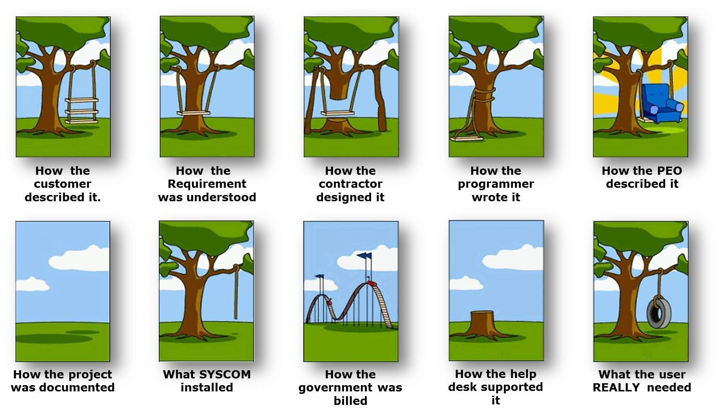
Design Practices

Slide 6
Lesson Plan Status
Software Configuration Management
Interface Management
Software Safety
Open Systems Approach (OSA)
Open Source Software
Data Management
Accessibility
Spectrum Management
Design Practices Exercise
DAG Chapter 4 Systems Engineering Design Considerations

Slide 7
Configuration Management Nightmares
(from “But I Only Changed One Line of Code” page 363)
Have Similar Things Happened to You?
A software bug that was fixed 6 months ago has reappeared.
A programmer just spent 12 hours making a change to the wrong version of the software.
There is no way to trace requirements from the requirements document to the user documentation and source code.
Two programmers working on a project have overwritten each other’s code—at least 80 hours of their work is now useless.
No one can find the latest version of the source code.
An application installed at various locations is running fine at some locations, but not at other locations.

Slide 8
Software Configuration Management (SCM)
Purpose: Establish and maintain integrity of software products throughout the software life cycle.
Goals:
  SCM activities are planned
  Software products are identified, controlled, and available
  Changes to software products are controlled
    Management review of impact of changes on cost, schedule, performance
  Affected groups and individuals are informed of the status and content of software baselines
Based on the Capability Maturity Model Integrated for Development, Version 1.3

Slide 9
Software Configuration Management (Defined)
A discipline applying technical and administrative direction and surveillance to:
Identify and document the functional and physical characteristics of a configuration item
Control changes to those characteristics
Record and report change processing and implementation status
Verify compliance with specified requirements

Slide 10

Software Configuration Management Terminology
SOFTWARE CONFIGURATION—the set of functional and physical characteristics of software as set forth in the technical documentation or achieved in a product
SOFTWARE CONFIGURATION ITEM (SCI) —an aggregation of software designated for configuration management; treated as a single entity in the SCM process
SOFTWARE BASELINE—a set of software configuration items formally designated and fixed at a specific time during the software life cycle
  Commonly used baselines are the functional, allocated, developmental, and product baselines
SOFTWARE VERSION—Software items evolve as a software project proceeds. A version of a software item is a particular identified and specified item.
  Revision - a new version of an item that is intended to replace the old version of the item.
  Variant - a new version of an item that will be added to the configuration without replacing the old
Definitions from IEEE Guide to the Software Engineering Body of Knowledge (SWEBOK), Version 3.0

Slide 11
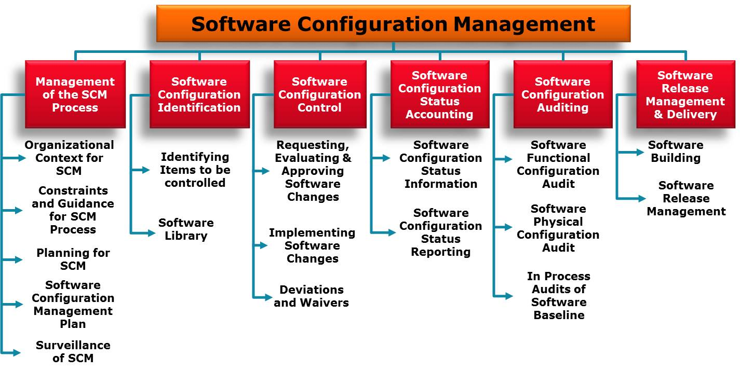
Software Configuration Management Activities
Based on IEEE Guide to the Software Engineering Body of Knowledge (SWEBOK), Version 3.0

Slide 12
Why is Software Configuration Management Problematic?
Increasing criticality of software in all products
Customers/users want the latest technology
Customers/users often change their minds
Software errors occur or are found throughout the product lifecycle
Multiple components, versions and variants
Incremental or spiral development makes CM more critical
Product life may be longer than planned
High integration and many interfaces make implementing changes difficult

Slide 13
Software CM Complications and Issues
Large development teams—who is changing what?
Parallel development—multiple people working on the same modules.
Geographically dispersed teams, or shift-based teams
Multiple versions for different target platforms
Mixture of COTS and custom software.
When does SCM begin? SCM can bog down rapid prototyping efforts.
Level of automation—how much manual effort is required to operate the SCM system?

Slide 14

Software CM and Shortcuts
Elephant Bungee Wisdom
Universal Truth # 6:
Management Emphasis
Use review boards to enforce CM
Allow no exceptions to CM rules
Anything that is shared by two or more people
should come under configuration control
Elephant Bungee Jumping # 6:
Help… I’ve Fallen and I Can’t Get Up

Slide 15
Lesson Plan Status
Software Configuration Management
Interface Management
Software Safety
Open Systems Approach (OSA)
Open Source Software
Data Management
Accessibility
Spectrum Management
Design Practices Exercise
DAG Chapter 4 Systems Engineering Design Considerations

Slide 16
Software Configuration Management and Interface Control
When a software item will interface with another software or hardware item, a change to either item can affect the other.
The planning for the SCM process considers how the interfacing items will be identified and how changes to the items will be managed and communicated.
Definitions from IEEE Guide to the Software Engineering Body of Knowledge (SWEBOK), Version 3.0

Slide 17
Interface Management Defined
Interface
  A boundary across which two independent systems meet and act on or communicate with each other
Interface Management
  The management of communication, coordination and responsibility across a common boundary between two organizations, phases, or physical entities which are interdependent.
  All of the interfaces between co-functioning items need to be identified and documented so that their integrity may be maintained through a disciplined configuration control process.

Slide 18
Interface Management Activities
Defining and establishing interface specifications
Assessing compliance of interfaces among configuration items comprising systems or system of systems
Monitoring the viability and integrity of interfaces within a system
Establishing an Interface Management Plan to assess existing and emerging interface standards and profiles, update interfaces, and abandon obsolete architectures

Slide 19
Interface Management Imperatives
Design and verify interfaces early in the Product Life Cycle
Control interfaces to ensure they are within designated boundaries
Design interfaces into program hierarchy
Develop an Interface Management Plan (IMP)
Develop Interface Control Working Groups (ICWGs)
Document interfaces and make available to stakeholders through Interface Control Documents (ICDs)

Slide 20
Interface Management Plan (IMP)
An IMP is a part of a configuration management plan that:
Documents a system’s internal and external interfaces and their requirement specifications
Identifies preferred and discretionary interface standards and their profiles
Provides justification for selection and procedure for upgrading interface standards
Describes the certifications and tests applicable to each interface or standard

Slide 21
ICDs and ICWGs
Interface Control Documents (ICDs)
  Documents interfaces
  Formal means of establishing, defining, and controlling interfaces and for documenting detailed interface design definition
  For each of the interface types, the ICD typically exists between configuration items to establish and specify interface definition and design
Interface Control Working Group (ICWG)
  A specialized technical working group comprised of appropriate technical representatives from the interfacing activities and other interested participating organizations.
  Serves as a forum to develop and provide interface requirements, as well as, focus on interface detail definition and issues
  Detailed description and requirements are provided in the ICWG Charter.

Slide 22
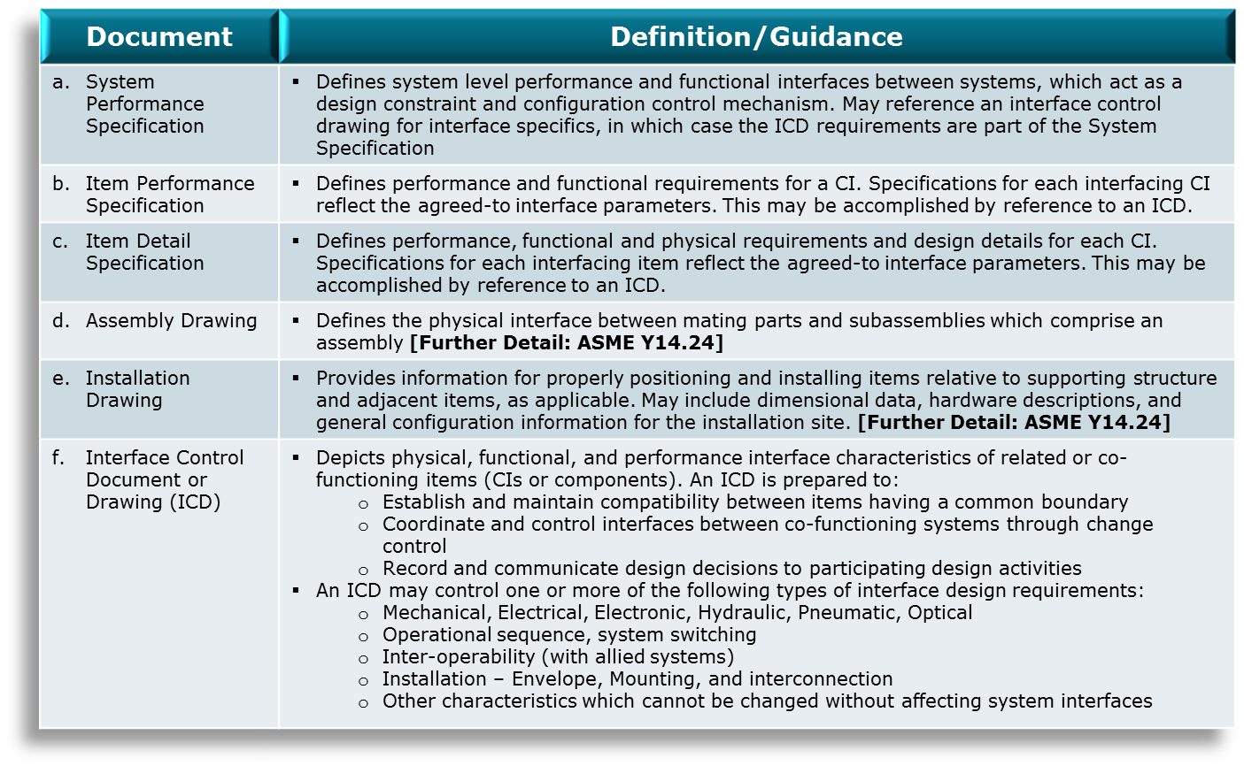
Documentation Defining Interfaces*
*Per MIL-HDBK-61A. Other documents include: Interface Requirements Specification, Interface Design Document, Control Drawing (Specification, Source), Vendor Item Description, Commercial Item Description, Purchase Description, etc.

Slide 23
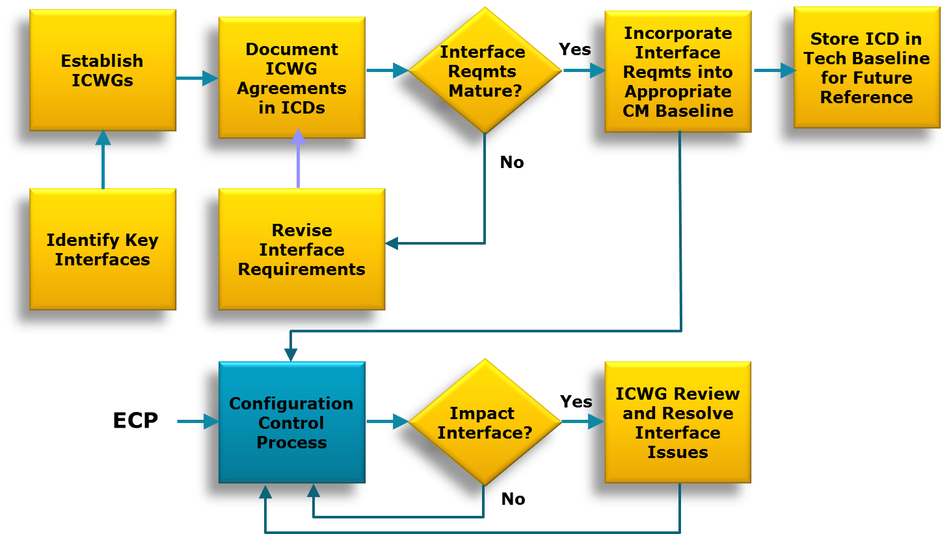
Interface Management
Process Flow
From MIL-HDBK-61A

Slide 24
Lesson Plan Status
Software Configuration Management
Interface Management
Software Safety
Open Systems Approach (OSA)
Open Source Software
Data Management
Accessibility
Spectrum Management
Design Practices Exercise
DAG Chapter 4 Systems Engineering Design Considerations

Slide 25
Software Safety
Both a subset of Software Development and Software System Safety
The process of identifying Safety-Critical Software and assessing the criticality
A series of requirements, design, and verification activities used to demonstrate that software will meet the customer’s safety requirements to an acceptable level of confidence
  This slide and the following 5 slides on Software Safety were adapted from “Software Safety Tutorial”. The 27th International System Safety Conference, Presented by Josh McNeil and Willie Fitzpatrick, PhD, August 2009

Slide 26
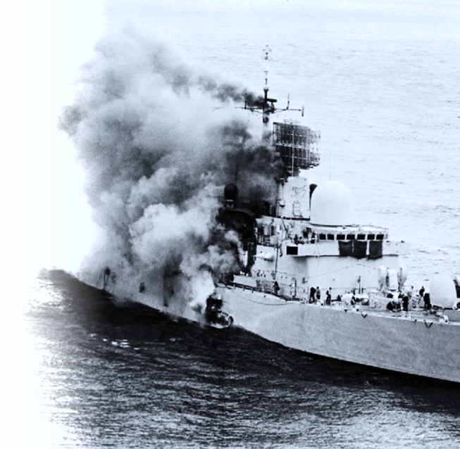
Software Safety Failure Example
The British destroyer H.M.S. Sheffield was sunk in the Falkland Islands war. According to one report, the ship's radar warning systems were programmed to identify the Exocet missile as "friendly" because the British arsenal includes the Exocet's homing device and allowed the missile to reach its target, namely the Sheffield.

Slide 27
Software Safety Failure Example
The Ariane 5 satellite launcher malfunction was caused by a faulty software exception routine resulting from a bad 64-bit floating point to 16-bit integer conversion

Slide 28
Software Safety Failure Example
An Iraqi Scud missile hit Dhahran barracks, leaving 28 dead and 98 wounded. The incoming missile was not detected by the Patriot defenses, whose clock had drifted 0.36 seconds during the 4-day continuous siege, the error increasing with elapsed time since the system was turned on. This software flaw prevented real-time tracking. The specifications called for aircraft speeds, not Mach 6 missiles, for 14-hour continuous performance, not 100. Patched software arrived via air one day later.

Slide 29
Software Safety Failure Example
Aegis was installed on the U.S.S. Ticonderoga, a Navy cruiser. After the Ticonderoga was commissioned the weapon system underwent its first operational test. In this test it failed to shoot down six out of 16 targets because of faulty software; earlier small-scale and simulation tests had not uncovered certain system errors. In addition, because of test-range limitations, at no time were more than three targets presented to the system simultaneously. For a sizable attack approaching Aegis' design limits the results would most likely have been worse.

Slide 30
Software Safety Definitions
Software System Safety—The optimization of system safety in the design, development, use, and maintenance of software systems and their integration with safety-critical hardware systems in an operational environment.
Safety-Critical—A term applied to a function, condition, event, operation, process, component, or other element of a system whose proper recognition, control, performance or tolerance is essential to safe system operation or use (e.g., safety-critical function, safety-critical path, safety critical component).
Safety-Critical Software Function (SCSF)—A function, whose proper execution is necessary to reduce the risk of a hazard OR if performed incorrectly, performed out-of sequence, or not performed could contribute to a hazard, compromise a safety mitigation feature, or result in a diminished level of safety.
Mishap—An unplanned event or series of events resulting in death, injury, occupational illness, or damage to or loss of equipment or property, or damage to the environment.
Hazard—Any real or potential condition that can cause:
  Injury, illness, or death to personnel;
  Damage to or loss of a system, equipment or property; or
  Damage to the environment.

Slide 31
Software Safety Ground Rules
Software is a hazard cause
  Software is a causal factor or contributes to a hazard
  Two types of hazardous functions
    Mitigating or “Must Work” functions (e.g. flight controls, …)
    Contributing or “Must Not Work” functions (e.g., premature missile firing, …)
Software hazard contributors result from inadequate System and Software design and requirements
  Caused by lack of design foresight, system development errors, inadequate requirements specifications, …
  Hardware failures can modify intended software behavior
Traditional Independent Verification & Validation (IV&V) does not address Software System Safety
  IV&V is focused on all mission critical software functions and not traditionally focused on safety-critical software functions
  Software System Safety focuses on safety-critical software functions as hazard causes

Slide 32
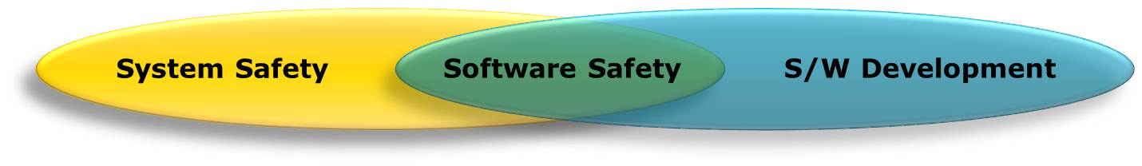
Safety of Software
Software System Safety
System Safety and Risk Assess Activities
System Safety Analyses to include software & hazard reports
Perform hazard risk assessments
Identify System Safety requirements Identification of safety critical software functions, safety-critical software requirements (SCRs), and associated criticality
Identification of risk mitigation and perform risk assessment
Produce Safety Assessment Report
Software Safety
Software Safety Development Assurance Activities
Participate in Hazard Analysis to identify specific S/W causes and faults
Assist in identification of safety-critical software functions, SCRs, & criticality
Flag SCRs & criticality in requirements traceability database
Trace requirements to design & code
Perform development assurance analyses and tests to ensure software meets (Level of Rigor) LOR & (Safety Integrity Level) SIL
Provide V&V evidence to System Safety for final risk assessment

Slide 33
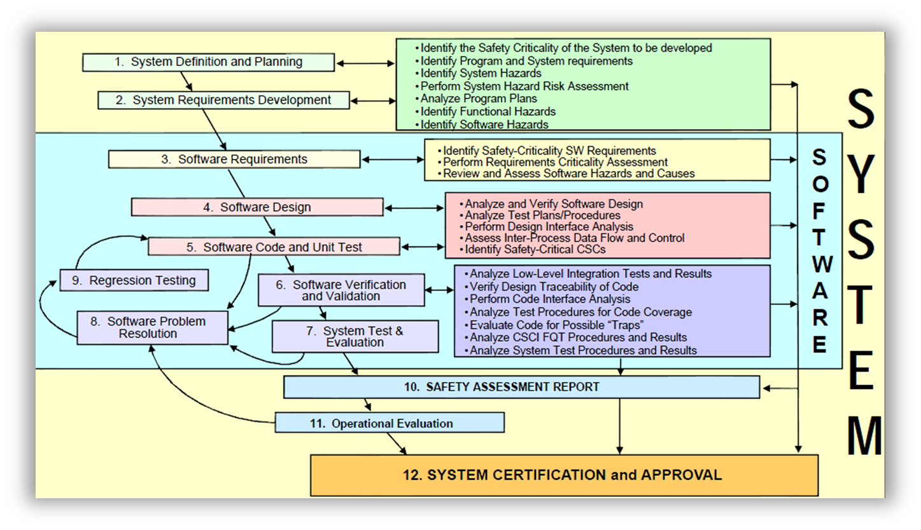
Software System Safety Analysis
SYSTEM AND SOFTWARE DEVELOPMENT LIFECYCLE
SYSTEM AND SOFTWARE
SAFETY CONTRIBUTIONS

Slide 34
Software Safety Lessons Learned
Most Software Safety problems come from vague or incomplete requirements that are misunderstood or misinterpreted.
Legacy/Reused software must be included in Software System Safety Analyses
Perform Software System Safety Analyses early in program lifecycle
Safety-Critical Software requirements derived from Software System Safety Analyses must be included and identified as Safety-Critical in the Software Requirement Specification (SRS)

Slide 35
Software Safety Lessons Learned (Continued)
Correct implementation of software exception handlers MUST BE VALIDATED (exceptions are runtime errors with undesired results or that disrupt normal program flow—handlers are built to assist the system to safely counteract the exception/error)
Safety concerns from Software System Safety Analysis must be addressed in Software Test Plans and Procedures (Boundary value testing, Full integration end-to-end testing)
Safety-Critical software must undergo full integration end-to-end testing, all software must be functioning and not inhibited

Slide 36
Lesson Plan Status
Software Configuration Management
Interface Management
Software Safety
Open Systems Approach (OSA)
Open Source Software
Data Management
Accessibility
Spectrum Management
Design Practices Exercise
DAG Chapter 4 Systems Engineering Design Considerations

Slide 37
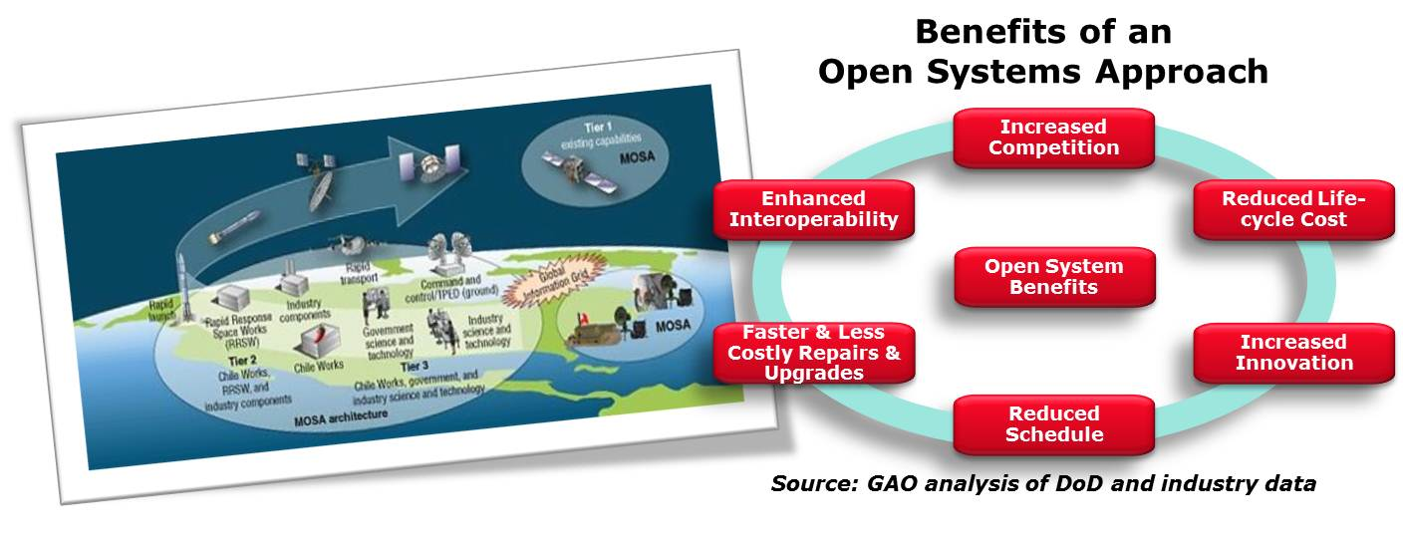
Open Systems Approach/Architecture (OSA)
Open Systems Architecture (OSA)*—OSA is a DoD-centric business and technical strategy for developing or modernizing (technology/weapons) systems that relies on modular design of components and utilizes open standards and specifications.
*Previously called MOSA: Modular Open Systems Approach

Slide 38
Defining “Open”
Open Source Software, Open Standards, Open System Architecture
Open Source Software—Copyright license terminology. End user granted specific rights to access, review, modify, distribute software without seeking permission from the copyright holder or paying license fees.
Open Standards—A general, descriptive term referring to publicly available standard for design.
(Modular) Open Systems Architecture (OSA)—OSA is a DoD-centric business and technical strategy for developing or modernizing (technology/weapons) systems that relies on modular design of components and utilizes open standards and specifications.

Slide 39
OSA Characteristics
An integrated business and technical strategy that:
  employs modular design,
  uses widely supported and consensus-based standards for their key interfaces, and
  has been subjected to successful validation and verification tests to ensure the openness of their key interfaces.
The DoD preferred approach for implementation of open systems is Open Systems Architecture (OSA).
DoDI 5000.02, 7 Jan 2015 states: “Program managers are responsible for applying open systems approaches in product designs …”

Slide 40
OSA Benefits
OSA is a strategy for developing a new system or modernizing an existing one.
OSA assists acquisition and engineering communities to design for affordable change, employ evolutionary acquisition and spiral development, and develop an integrated roadmap for system design and development.
Basing design strategies on widely supported open standards increases the chance that future changes to the system will be integrated in a cost-effective manner.
http://www.acq.osd.mil/se/initiatives/init_osa.html

Slide 41
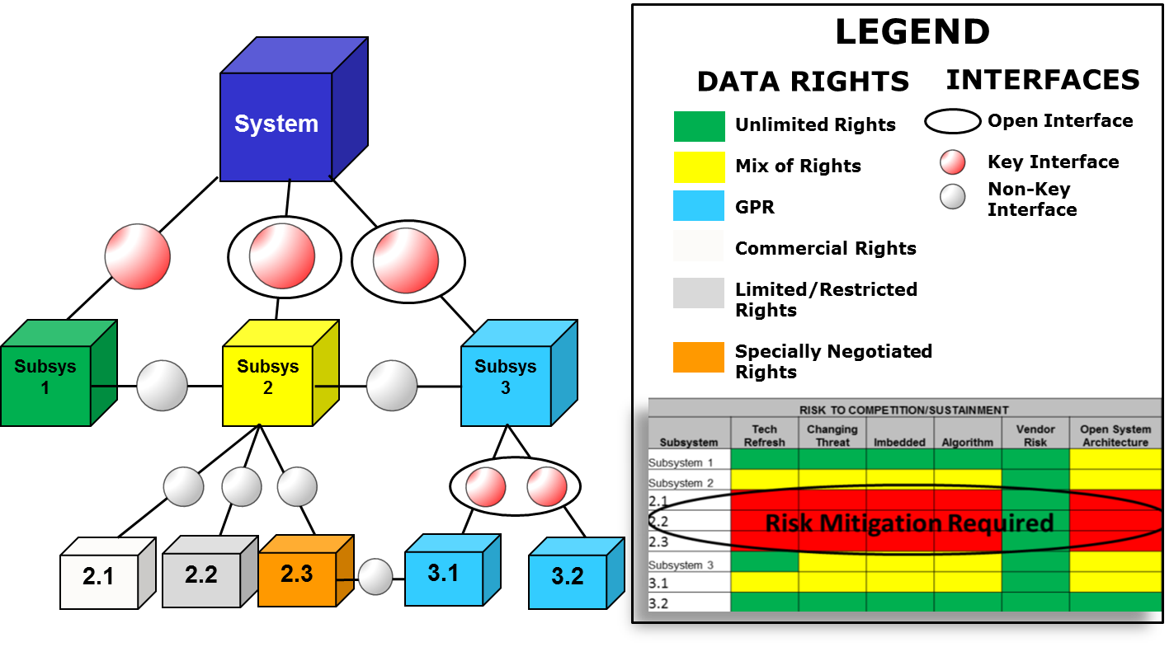
Example Open Systems Approach (OSA)
http://acqnotes.com/acqnote/careerfields/modular-open-systems-approach

Slide 42
GAO Calls for Open UAS Systems
GAO Report—DoD Efforts to Adopt Open Systems for its Unmanned Aircraft Systems (UAS) Have Progressed Slowly (http://gao.gov/products/GAO-13-651—July 31, 2013)
An open systems approach ...allows components to be replaced easily.
...open systems offers significant repair, upgrade and competition benefits that could translate to millions of dollars in savings...
  Traditionally, DoD has acquired proprietary systems, which are costly to upgrade and limit opportunities for competition. Through its Better Buying Power initiatives, DoD has re-emphasized the use of an open systems approach as a way to reduce costs through effective competition.
Navy used open systems for air vehicle, ground control station and payloads for three of four systems and anticipates significant efficiencies
Until DoD ensures that the services are incorporating open systems...it will continue to miss opportunities to increase the affordability of its acquisition programs.

Slide 43
Open Systems Requirements
Open system features may be specified as:
design requirements (e.g., mandated open standards and protocols);
derived requirements (e.g., need for open interfaces to facilitate interoperability);
design constraints (e.g., need to adhere to open interface specifications as system components are designed);
architectural attributes (e.g., need for an adaptable, upgradable, and reconfigurable system architecture);
design considerations (e.g., taking into consideration modular and open systems design benefits and concerns); and
business strategies to gain access to competitive sources of supply and effectively manage technological obsolescence.

Slide 44
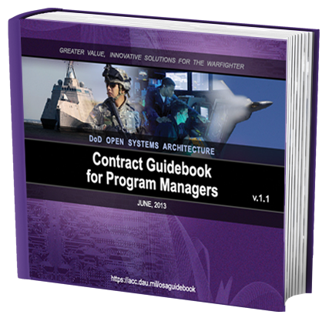
DoD OSA Guidebook
The guidebook provides recommendations for writing an OSA-based statement of work, guidance on special interest requirements, recommended contract line items, and guidance on obtaining intellectual property and data rights to support full life-cycle competition and recommended CDRLs.

Slide 45
Lesson Plan Status
Software Configuration Management
Interface Management
Software Safety
Open Systems Approach (OSA)
Open Source Software
Data Management
Accessibility
Spectrum Management
Design Practices Exercise
DAG Chapter 4 Systems Engineering Design Considerations

Slide 46
Free and Open Source Software (FOSS)
Open source doesn't just mean access to the source code:
  Free redistribution
  Source code
  Derived works
  Integrity of the author's source code
  No discrimination against persons or groups
  No discrimination against fields of endeavor
  Distribution of license
  License must not be specific to a product
  License must not restrict other software
  License must be technology-neutral
Opensource-http://opensource.org/

Slide 47

FOSS Examples
Well known:
  Mozilla (Firefox, Thunderbird, Sunbird, Seamonkey)‏
  Java
  Open Office
  Linux
  Apache
  Perl
  Python
  Ruby

Slide 48

Who's Using FOSS
Every branch of US government
Google
Yahoo
Ticketmaster
Hackers
IBM
Sun
Oracle
Regular people—you!

Slide 49

FOSS Advantages
Try Before You Buy
Security (also a disadvantage)
Quality
  A software package created by a handful of developers, or a software package created by thousands of developers?
Cost
Support Options
Interoperability
Code Coverage Tools

Slide 50
FOSS Disadvantages
Security (also a Advantage)
Probably not optimized for the functions you need performed.
May require sophisticated professional guidance on licensing issues
May have little documentation
“Hidden” costs
  Hosting, training, etc.
Project longevity/support
  Developers could lose interest
  and leave
No one is obligated to help you

Slide 51

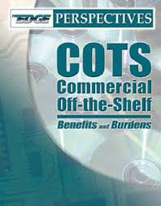
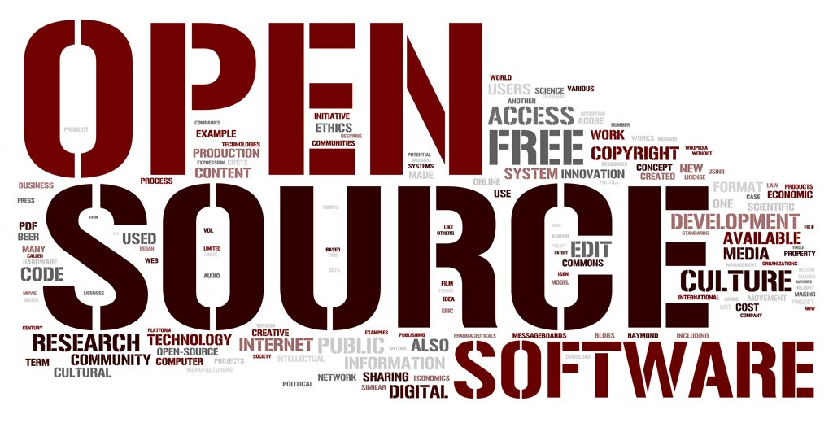
What's the difference?
COTS
GOTS
FOSS
Freeware

Slide 52
Lesson Plan Status
Software Configuration Management
Interface Management
Software Safety
Open Systems Approach (OSA)
Open Source Software
Data Management
Accessibility
Spectrum Management
Design Practices Exercise
DAG Chapter 4 Systems Engineering Design Considerations

Slide 53
Data Management
Definition
  The process of applying policies, procedures, and tools for the identification and control of data requirements, for assuring the adequacy of data and for facilitating the timely, economical acquisition and availability of data, including digital delivery or access. In simple terms, DM is the process for the acquisition of data (access or delivery) through contractual vehicles, so that data is available for use by authorized users. The type of data to which this applies includes research and development, acquisition, and logistics information.
Critical to the process of system design and development.
Data management and standardization reduces the cost, complexity, and overall level of resources expended on the development of software and computer system data components

Slide 54
Software Development and Data Rights
Data rights refer to intellectual property regarding the use of the data developed, accessed, and/or delivered under a Government contract.
Involve proprietary, restrictive, Government purpose, unlimited, limited, and may include patents, copyrights, and other data right provisions.
Necessary in the determination of release, duplication, and disclosure of technical data.
Data rights are generally determined by whose money is used in the development of the data.
  If the data is developed with Government funding, then the Government has the right to access and receive the data with unlimited rights.
  If data is developed with private sector funding, the Government, generally, will be allowed Government Purpose Rights.
The FAR 52.227 and DFARS 252.227 and other related sections set forth the policies, procedures, and implementing instructions relating to the requirements for the acquisition of technical data and computer software.
The Government should review the validity of any asserted restriction on technical data under a contract before acceptance of the data, but not later than three years after data delivery or final payment, whichever is later.
Source: Acquisition Data Management: Body of Knowledge (acc.dau.mil)

Slide 55
Data Management Policy
Data is an essential enabler of network-centric warfare (NCW) and shall be made visible, accessible, and understandable …
Data assets shall be made visible by creating and associating metadata (“tagging”) …
Data assets shall be made accessible by making data available in shared spaces.
Data assets shall be made understandable by publishing associated semantic and structural metadata in a federated DoD metadata registry
To enable trust, data assets shall have associated information assurance and security metadata, and an authoritative source … shall be identified …
Data interoperability shall be supported by making data assets understandable and by enabling business and mission processes to be reused where possible
Semantic and structural agreements for data sharing shall be promoted through communities (e.g., communities of interest (COIs)), …
Data sharing concepts and practices shall be incorporated into education and awareness training and appropriate DoD processes.
Sharing Data, Information, and Information Technology (IT) Services in the Department of Defense August 5, 2013

Slide 56
Lesson Plan Status
Software Configuration Management
Interface Management
Software Safety
Open Systems Approach (OSA)
Open Source Software
Data Management
Accessibility
Spectrum Management
Design Practices Exercise
DAG Chapter 4 Systems Engineering Design Considerations

Slide 57
Section 508 Amendment To The
Rehabilitation Act Of 1973
What is the purpose of this law?
The purpose of Section 508, Title 29 U.S. Code paragraph 794.d, is to provide disabled employees and members of the public access to information that is comparable to access available to others (unless undue burden would be imposed on the agency).
Why is this important to acquisition professionals?
Addresses electronic and information technology (EIT) procurement, development, maintenance and use.
Section 508 standards apply to people with visual, auditory, physical, speech, cognitive and neurological impairments.
Section 508 lists the types of technologies that must be included in designing accessible systems.
Section 508 identifies the exceptions to 508 accessibility requirements .
(Accessibility guidance is also addressed in FAR Subpart 39).

Slide 58
Americans With Disabilities Act -
User Accessibility
When acquiring EIT, agencies must ensure that:
Federal employees with disabilities have access to and use of information and data that is comparable to the access and use by Federal employees who are not individuals with disabilities; and;
Members of the public with disabilities seeking information or services from an agency have access to and use of information and data that is comparable to the access to and use of information and data by members of the public who are not individuals with disabilities.
EIT Section 508 Compliant list
Software applications and operating systems
Video and multimedia products
Self-contained, closed products (e.g., information Web-based information or applications kiosks, calculators, and fax machines)
Telecommunication products
Desktop and portable computers

Slide 59
Lesson Plan Status
Software Configuration Management
Interface Management
Software Safety
Open Systems Approach (OSA)
Open Source Software
Data Management
Accessibility
Spectrum Management
Design Practices Exercise
DAG Chapter 4 Systems Engineering Design Considerations

Slide 60
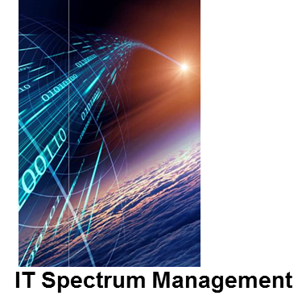
Why Do Spectrum Management?
Today, most military systems depend on the spectrum to interoperate.
DoD does not own all of the spectrum in the United States.
NOTE: In emergencies, the Federal Emergency Management Agency (FEMA) activates the National Response Framework (NRF) allowing the Federal Communications Commission (FCC) and the National Telecommunications and Information Administration (NTIA) to allocate spectrum back to DoD Mission Systems.
We don’t own the spectrum in foreign countries.
Managing electromagnetic spectrum achieves electromagnetic compatibility for smooth operational capabilities.
Continuous spectrum management is necessary due to continuous competition to use spectrum.
Loss of spectrum means loss of your ability to communicate and interoperate.
Spectrum management is critical to operational mission readiness.

Slide 61
Best Practices of
Spectrum Management
Early in your program, use DoDI 4650.01, January 9, 2009, “Policy and Procedures for Management and Use of the Electromagnetic Spectrum,“ to:
  Identify spectrum-related risks as early as possible via spectrum supportability risk assessments.
  Review these assessments at acquisition milestones.
  Manage the risks throughout the system’s lifecycle.
Early in your program, use DoDI 5000.02, January 7, 2015, “Operation of the Defense Acquisition System, “ to:
  File the Frequency Allocation Application (DD Form 1494) IAW Enclosure 1, Table 2.
  Create and manage the Spectrum Supportability Risk Assessment IAW Enclosure 1, Table 2.
  Comply with paragraph 19. Spectrum Supportability, Enclosure 3
Work with the Defense Spectrum Office (DSO) to help guide you through the complex spectrum development, management and approval processes for all possible deployment scenarios.

Slide 62
Lesson Plan Status
Software Configuration Management
Interface Management
Software Safety
Open Systems Approach (OSA)
Open Source Software
Data Management
Accessibility
Spectrum Management
Design Practices Exercise
DAG Chapter 4 Systems Engineering Design Considerations

Slide 63
Design Practices Exercise
Each team prepare a short (10 min) presentation for the class
      Define and explain in your own words one of the five (5) IT design practices:
        Team 1—Software Configuration Management
        Team 2—Interface Management
        Team 3—Open Source
        Team 4—Open Systems Approach
        Team 5—Software Safety
      Provide an example of your design practice for an existing or planned DoD IT system. JTAMS may be selected as your system.
      How would your design practice impact each of the following: system cost, schedule, performance and risk?
Use the available lesson materials or other resources to develop your brief (DAG [Ch 4, 7], AKSS, Google, etc.)
Presentations start in 45 to 60 minutes.
Include
Implications
For
Accessibility

Slide 64
Today we learned to:
Relate reasons why Configuration Management (CM) is critical to the success of Software Intensive Systems.
Identify at least three reasons why interface management and documentation are important to the development of DoD Software Intensive Systems.
Identify the underlying reasons for DoD policy regarding employing an Open Systems Approach (OSA) and its associated principles.
Recognize potential areas of software safety issues and risks when reviewing acquisition documents.
Explain the characteristics and importance of sound data management practices during the development process.
Describe why continuing the spectrum management process throughout the lifecycle of an IT program is critical.
Recognize the benefits of using Open Source Software in your systems design.
Discuss how designing for accessibility impacts software development for DBS and DoD Infrastructure systems

