Slide 1
ISA 201 Intermediate Information Systems Acquisition

Slide 2
Lesson 12 DoD Cloud Computing

Slide 3
In-Class Quiz
Team 1
True or False: According to the DoD Chief Information Officer (CIO), DoD components are required to use the Defense Information Systems Agency (DISA) to acquire cloud services.
Team 2
The _____________ provided cloud services must be considered as part of the Enterprise IT Business Case Analysis (BCA) performed by the Component for cloud services.
Team 3
The __________________________ is intended to give cloud providers a stable security requirement, and to help DoD cloud customers move more rapidly and securely into the cloud.
Which of the following is NOT a benefit of Cloud Computing per the DoD Cloud Computing Strategy? De-coupled from private sector innovation; Enables improved asset utilization; Allows for near-instantaneous increases and reductions in capacity; Shifts focus from asset ownership to service management
Team 4
Team 5
According to the DoD Cloud Computing Strategy, what are the three areas DoD can benefit from by moving to cloud computing?

Slide 4
Lesson Plan
Cloud Laws, Policies, Guidance and Standards
Cloud Basics and Benefits
Cloud Computing Definition
Concerns with using Cloud
Exercise

Slide 5
Lesson Plan Status
Cloud Laws, Policies, Guidance and Standards
Cloud Basics and Benefits
Cloud Computing Definition
Concerns with using Cloud
Exercise

Slide 6

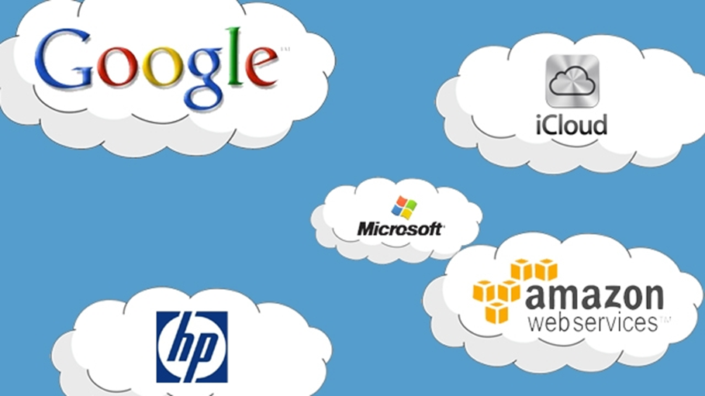
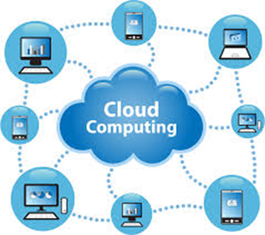
What’s the Cloud?
Okay, so we know there are Federal and DoD policies and direction to consolidate data centers and move our IT infrastructure to the cloud when it makes fiscal and security sense, but what is “the cloud”?

Slide 7
Official DoD Definition of Cloud Computing
Cloud computing is a model for enabling ubiquitous, convenient, on-demand network access to a shared pool of configurable computing resources (e.g., networks, servers, storage, applications, and services) that can be rapidly provisioned and released with minimal management effort or service provider interaction.
NIST Special Publication 800-145

Slide 8
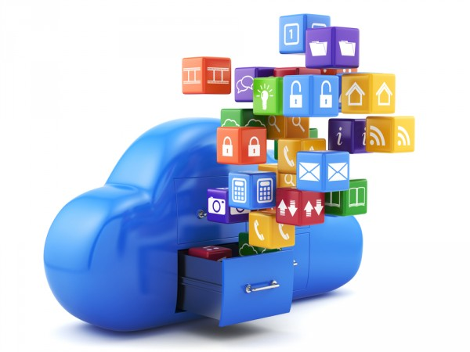
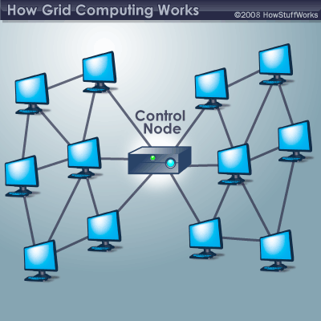
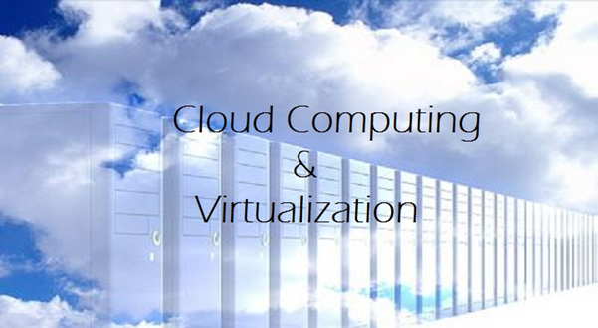
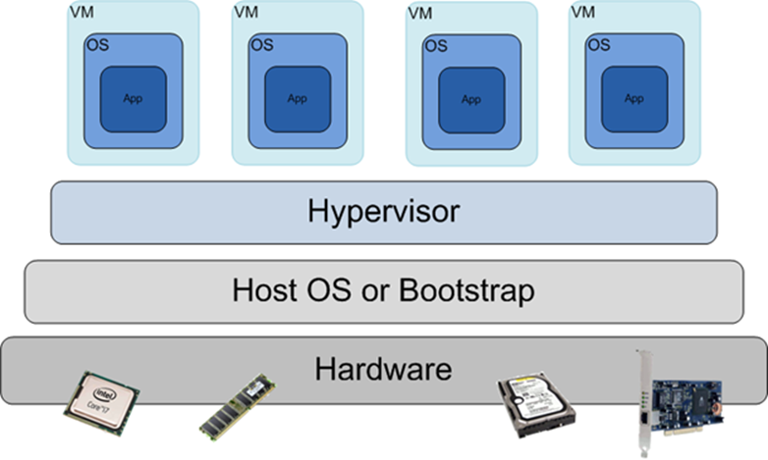
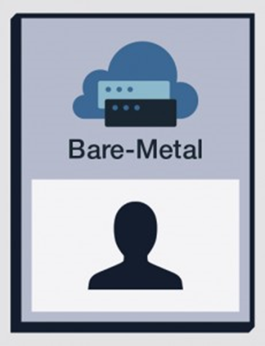
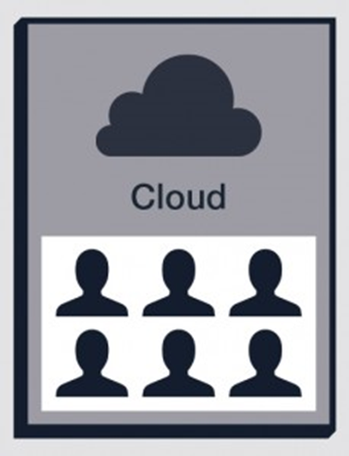
Basic Cloud Computing Terminology
Cloud Computing
Bare Metal/Single Tenancy
Multi-Tenancy
Service Oriented Architecture
Cloud Computing
Grid Computing
Virtualization
Bare Metal/ Single Tenancy
Multi-Tenancy
Hypervisor

Slide 9
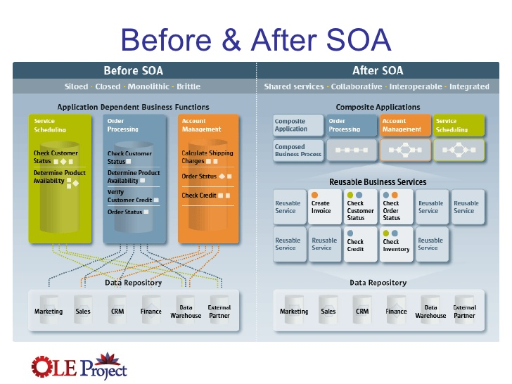
Service Oriented Architecture
Service-oriented architecture (SOA) is a software design in which application components provide services to other components via a communications protocol, typically over a network.

Slide 10
Advancements in technology that enabled the rise of cloud computing
The present availability of high-capacity networks and low-cost computers (commodity hardware), together with the adoptions of virtualization, widely adopted open standards, and service-oriented architecture, have led to present day cloud computing.
Low-cost Commodity Hardware
High Capacity (Storage and Processing)
Broadband/always-on network access
Virtualization (primary enabling technology behind cloud computing)
Programmable Infrastructure/Auto-configure (i.e. elasticity)
Open Application Program Interfaces
Service Oriented Architecture

Slide 11
Benefits of Consuming Cloud Services
Benefits DoD can derive from Cloud Computing are Efficiency, Agility and Innovation.
Cloud computing technologies offers a way for the DoD to lower costs, improve performance, increase utilization and security, and take advantage of innovation taking place in the commercial industry.
Allows organizations to focus on their core mission instead of building and managing IT solutions, like data centers.
Cloud computing allows for rapid improvements to infrastructure, services and technology that is not possible with traditional IT acquisitions.

Slide 12
Lesson Plan Status
Cloud Laws, Policies, Guidance and Standards
Cloud Basics and Benefits
Cloud Computing Definition
Concerns with using Cloud
Exercise

Slide 13
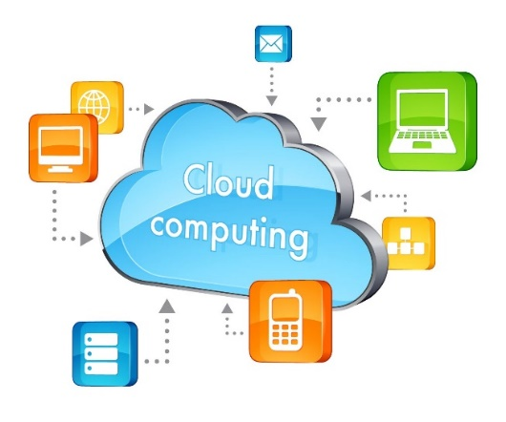
The Composition of the Cloud
The “Cloud” is composed of
five essential characteristics,
three service models,
four deployment models
NIST Special Publication 800-145

Slide 14
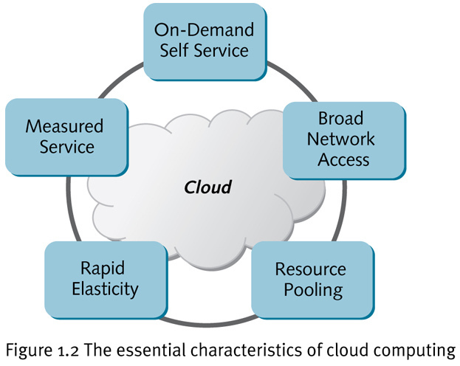
5 Essential Cloud Characteristics
According to the NIST Special Publication 800-145, the Cloud model is composed of five essential characteristics:
On-demand self-service
Broad network access
Resource pooling
Location independence
Rapid elasticity
Measured service
NIST Special Publication 800-145

Slide 15
The 3 Cloud Service Models
Infrastructure as a Service (IaaS)
Rent processing, storage, network capacity, and other fundamental computing resources
Platform as a Service (PaaS)
Deploy customer-created applications to a cloud
Software as a Service (SaaS)
Use provider’s applications over a network
To be considered “cloud” the Cloud Service Models must be deployed on top of cloud infrastructure that has the key characteristics

Slide 16
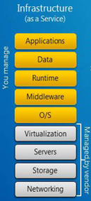
Infrastructure as a Service (IaaS)
Provisioning processing, storage, networks, and other fundamental computing resources where the consumer is able to deploy and run arbitrary software, which can include operating systems and applications.
The consumer does not manage or control the underlying cloud infrastructure but has control over operating systems, storage, and deployed applications; and possibly limited control of select networking components (e.g., host firewalls).

Slide 17
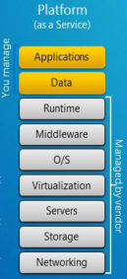
Platform as a Service (PaaS)
Deployed onto the cloud infrastructure consumer‐created or acquired applications created using programming languages, libraries, services, and tools supported by the provider.
The consumer does not manage or control the underlying cloud infrastructure including network, servers, operating systems, or storage, but has control over the deployed applications and possibly configuration settings for the application‐hosting environment.

Slide 18
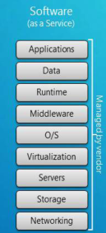
Software as a Service (SaaS)
Using the provider’s applications running on a cloud infrastructure. The applications are accessible from various client devices through either a thin client interface, such as a web browser (e.g., web‐based email), or a program interface.
The consumer does not manage or control the underlying cloud infrastructure including network, servers, operating systems, storage, or even individual application capabilities, with the possible exception of limited user‐specific application configuration settings.

Slide 19
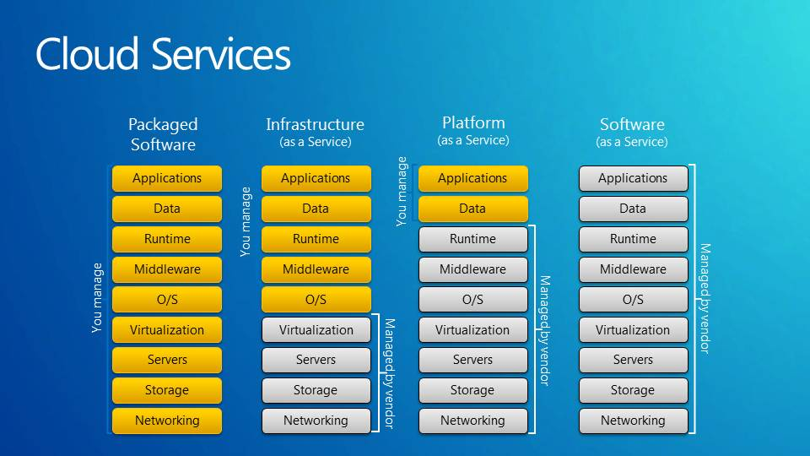
Management Responsibilities with the 3 Cloud Service Models
Cloud Services offers a way for the DoD to lower costs, improve performance, increase utilization and security, and take advantage of commercial innovation

Slide 20
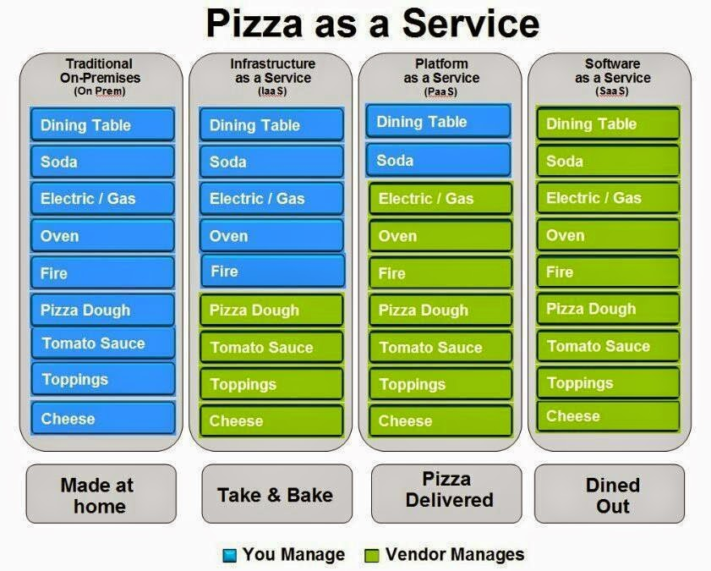
Pizza as a Service

Slide 21
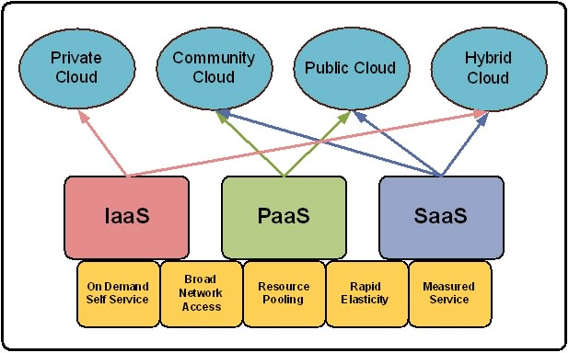
The 4 Cloud Deployment Models
Cloud services can be deployed in different ways depending on the customer’s specific needs, such as security, privacy, and cost.
Private cloud
Community cloud
Public cloud
Hybrid cloud
NIST Special Publication 800-145

Slide 22
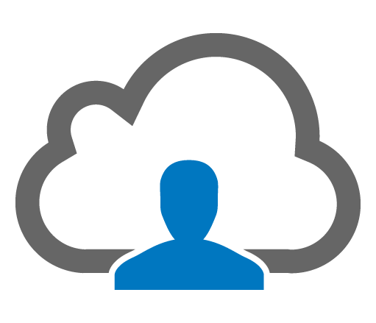
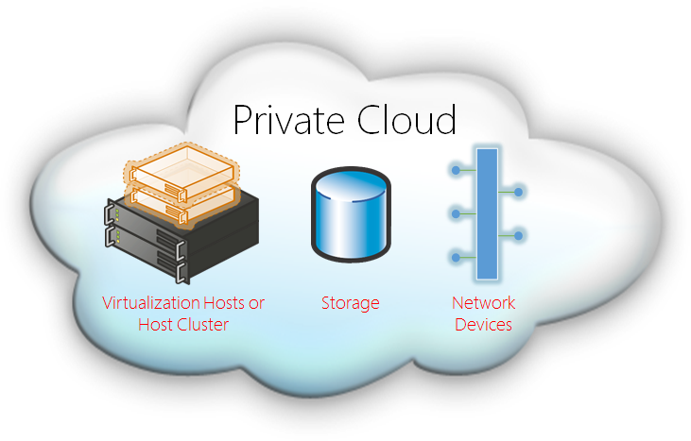
Private Cloud Deployment Model
Private cloud infrastructures are operated only for an individual organization (Single Tenant).
The organization can leverage the scalability and performance aspects of cloud computing, but the infrastructure is isolated from that of other organizations, improving security and privacy.
Because of their specialized nature, private clouds could potentially be as costly as dedicated data centers.
For example, the DoD has a Private Cloud, milCloud, which is operated by DISA.

Slide 23
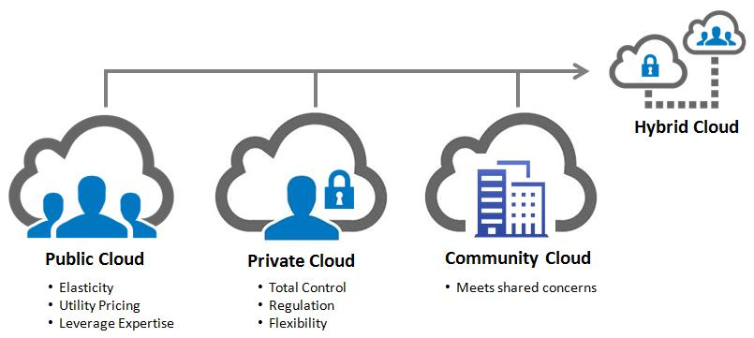
Community Cloud Deployment Model
Community cloud infrastructures are private clouds provisioned for a specific community of interest with shared concerns, such as a government-only cloud.
The Community cloud infrastructure is provisioned for exclusive use by a specific community of consumers from organizations that have shared concerns (e.g., mission, security requirements, policy, and compliance considerations).
Community clouds may be owned, managed, and operated by one or more of the organizations in the community, a third party, or some combination of them, and it may exist on or off premises.

Slide 24
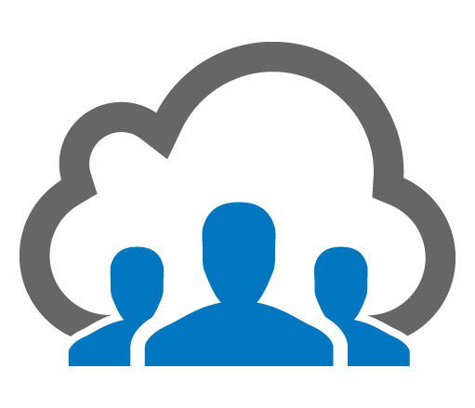
Public Cloud Deployment Model
Public cloud infrastructures operate in a multi-tenant environment whose resources are allocated for the general public.
Public clouds tend to be large and provide economies of scale for their customers.
Security and privacy concerns are heightened because any individual or organization can potentially access the same cloud infrastructure.
Only DoD information that has been approved for public release should be placed on a public facing website.

Slide 25
Hybrid Cloud Deployment Model
Hybrid cloud infrastructures are combinations of any two or more of the other cloud deployment models.
This model will be the most prevalent model for the DoD given its strategy to aggressively pursue the competitive acquisition and use of commercial cloud service offerings and understanding that “one cloud’ will not meet all the unique requirements of the DoD.
One example of Hybrid Cloud is used in the Development – Test – Production software lifecycle.

Slide 26
Lesson Plan Status
Cloud Laws, Policies, Guidance and Standards
Cloud Basics and Benefits
Cloud Computing Definition
Concerns with using Cloud
Exercise

Slide 27

DoD’s Concerns of Using Cloud Services
Data Security
Location of DoD data
Comingling of DoD data with other
customer’s data
Physical security of data center
Latency
Network congestion/bandwidth availability
Remote cloud data centers
Unanticipated costs
Network upgrades to maintain performance (increased bandwidth demands)
Strict security requirements (e.g. Private vs Public)
Cybersecurity: Protecting the DoDIN
The DoDIN is a critical infrastructure to the DoD Mission

Slide 28
Cybersecurity is a Concern when using Cloud Services
The Mission Owner must consider Risk to Data (referred to as Information Impact Level) and Risk to the DoDIN
Higher Information Impact Levels require additional security in the form of a Cloud Access Point
With respect to Cloud Computing, “Mission” refers to the information systems and function for which a DoD entity acquires or uses a Cloud Service
Overall Mission will be assessed and authorized by the Mission Owner’s Authorizing Official (AO) IAW the DoD Cloud Computing Security Guide
FedRAMP Moderate
DoD Provisional Authorization
Authority to Operate

Slide 29
Program concerns when purchasing commercial cloud services
Cloud Service Provider Maturity
Jurisdiction/Location Requirements
Deployment Model Considerations/Separation Requirements
Encryption
Monitoring and Incident Reporting Requirements
CSP Personnel Requirements
Physical Access
Legacy Software Interoperability

Slide 30
Problems with legacy software applications and the cloud
Legacy software applications were not designed to be virtualized
Redesigning legacy software applications to utilize cloud services can be cost prohibitive
Legacy software applications that are tightly integrated with a computer’s operating system are extremely difficult to migrate to the cloud
Software that is encapsulated from the operating system has a better chance of migrating to the cloud
Encapsulation means there is no direct dependency on any one operating system

Slide 31
Lesson Plan Status
Cloud Laws, Policies, Guidance and Standards
Cloud Basics and Benefits
Cloud Computing Definition
Concerns with using Cloud
Exercise

Slide 32
Cloud Computing Exercise Team 1
Read the articles
“Army Taps IBM Cloud Computing to Help Manage Its Logistics Enterprise”
“In Pentagon’s belated march to the cloud, DoD CIO looks to spark national dialogue on cloud security”
“Army begins shopping for cloud vendors to host its enterprise apps”
Describe the characteristics of the commercial cloud services
The commercial cloud deployment approach, and
The DoD potential benefits and concerns with using it

Slide 33
Cloud Computing Exercise Team 2
Read the DoD IG’s report, “DoD Needs an Effective Process to Identify Cloud Computing Service Contracts.”
Summarize the DoD IG’s findings.
What is the issue with the DoD not having its own definition of Cloud Computing?
Do you agree with the DoD CIO’s response? Why or why not?
How might you have addressed the findings?

Slide 34
Cloud Computing Exercise Team 3
Using the DoD’s Cloud Computing Security Requirements Guide,
Present to the class the process for obtaining an Authority to Operate for a commercial cloud service offering that will host Controlled Unclassified Information.
Describe the difference between a Cloud Service Provider and a Cloud Service Offering
Identify mandatory considerations the mission owner Authorizing Official must determine when moving to the cloud

Slide 35
Cloud Computing Exercise Team 4
Given that a DoD Agency desires migrating its public affairs news files to the cloud,
Identify which of the three cloud service models the agency could use from a commercial cloud service provider
Identify the characteristics of the model(s)
Give examples of how the agency could use the models to perform its public affairs mission
Recommend a cloud deployment model or models for the agency’s public affair mission
Conduct Internet research to identify a viable commercial solution and describe what steps have been taken so far

Slide 36
Cloud Computing Exercise Team 5
Given that a DoD Agency desires migrating its military medical files and email capability to the cloud,
Identify which of the three cloud service models the agency could use from a commercial cloud service provider
Identify the characteristics of the model(s)
Give examples of how the agency could use the models to perform its health services mission
Recommend a cloud deployment model or models for the agency’s health services mission
Conduct Internet research to identify a viable commercial solution and describe what steps have been taken so far

Slide 37
Today we learned a lot about Cloud Computing
Cloud laws, policies, standards, and guidance
Basic cloud computing terms
Advancements in technology enabling cloud services
Benefits and DoD concerns with consuming cloud services
Cloud computing definition
Five essential characteristics of cloud
Three cloud service models
Four cloud deployment models
Challenges with migrating legacy applications to the cloud

